Slide 1

Visual Methods for Deep Explanation in Machine Learning
Boris Kovalerchuk¹ Muhammad Aurangzeb Ahmad^{2,3} Ankur Teredesai^{2,3}
[1] Dept. of Computer Science, Central Washington University
[2] Dept. of Computer Science and Systems, University of Washington Tacoma
[3] KenSci Inc.

Slide 2
Outline
Foundations of Interpretability
Discovering Visual Interpretable Models
Limits of Visual Interpretability in Deep Learning
User-centric Views of Interpretability of Visual Methods
Open Problems and Current Research Frontiers

Slide 3
Foundations of Interpretability

Slide 4


Types of Machine Learning Models
White Box or Glass Box: There is an explanation about how the model is making predictions Examples: Decision Trees, Rule Lists etc.
Black Box: There is no explanation with respect to how the model is making predictions. Examples: SVMs, Random Forest, Gradient Descent Models etc.

Slide 5
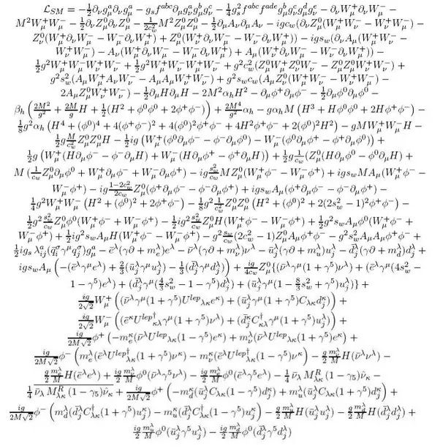
Explainable AI / Interpretable Machine Learning
Explainable AI or interpretable machine learning: Giving explanations of AI/machine learning models to humans with domain knowledge
Explanation: Why is the prediction being made?
Explanation to Human: The explanation should be comprehensible to humans in (i) natural language (ii) easy to understand representations
Domain Knowledge: The explanation should make sense to a domain expert
[Craik 1967, Doshi-Velez 2014]
Standard Model Lagrangian

Slide 6
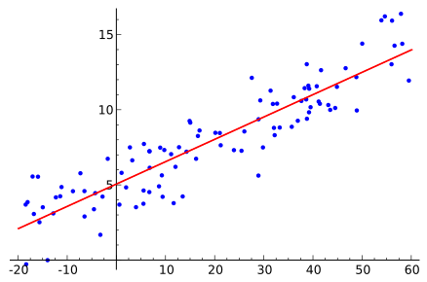
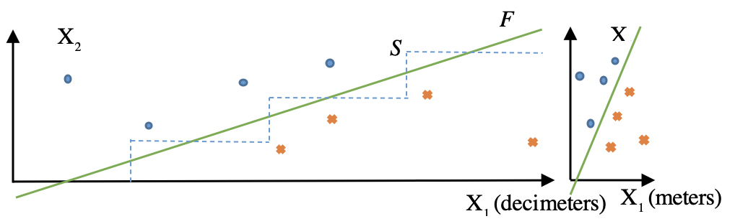
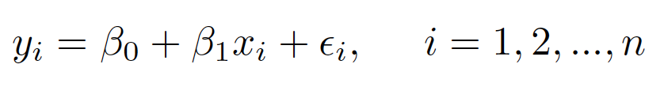
What is Interpretability?
We can solve the problem of interpretation of a linear model by interpolating it by a set of logical rules. In this way, a quasi-explainable model is converted to an explainable one
[Ahmad 2018; Kovalerchuk 2019]
Notes:
However, typically in ML, attributes are heterogeneous as in medical diagnostics: blood pressure, cholesterol level, temperature and so on in a single dataset for a given time. The weighted summation of such heterogeneous attributes has no much physical meaning. Thus, an explanation that uses summation of heterogeneous attributes can be at best a quasi-explanation, but definitely not a deep explanation.

Slide 7
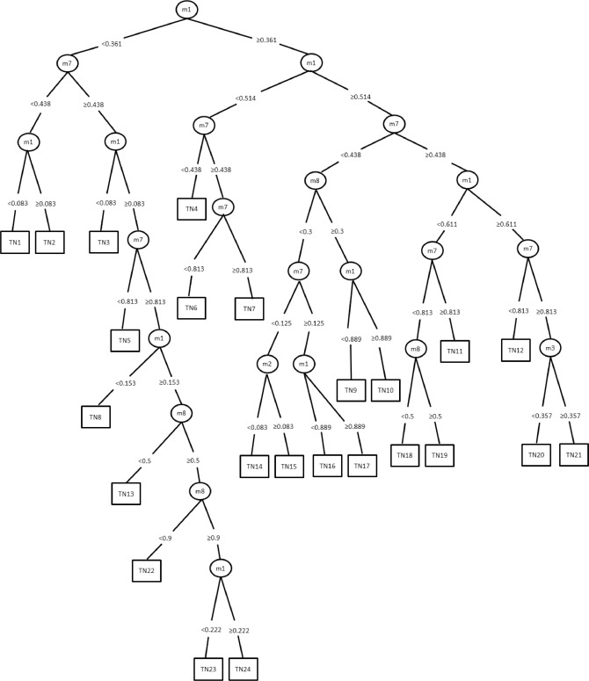
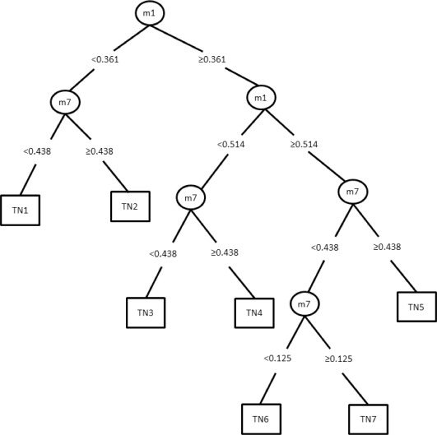
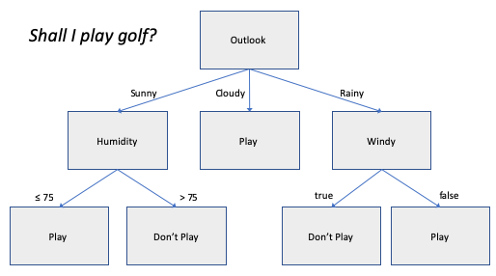
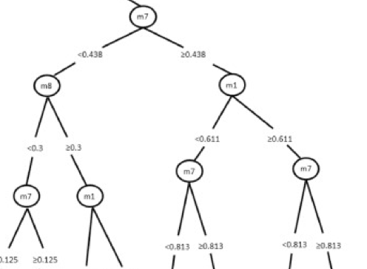
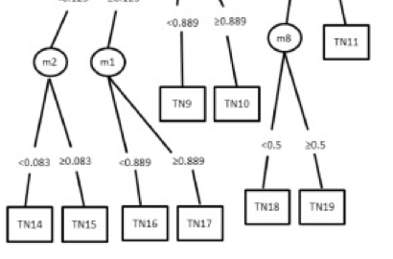
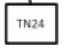
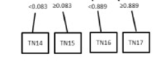
What is Interpretability?
Decision Tree B
Decision Tree A
[Ahmad 2018]

Slide 8
Definitions
Definition (Comprehensibility, C(S, P))
The comprehensibility of a definition (or program) P with respect to a human population S is the mean accuracy with which a human s from population S after brief study and without further sight can use P to classify new material sampled randomly from the definition’s domain
Definition (Inspection time T (S, P))
The inspection time T of a definition (or program) P with respect to a human population S is the mean time a human s from S spends studying P before applying P to new material
Definition (Textual complexity, Sz(P))
The textual complexity Sz of a definition of definite program P is the sum of the occurrences of predicate symbols, functions symbols and variables found in P
[Muggleton et al 2018]
Notes:
These definitions allow studying comprehensibility experimentally

Slide 9
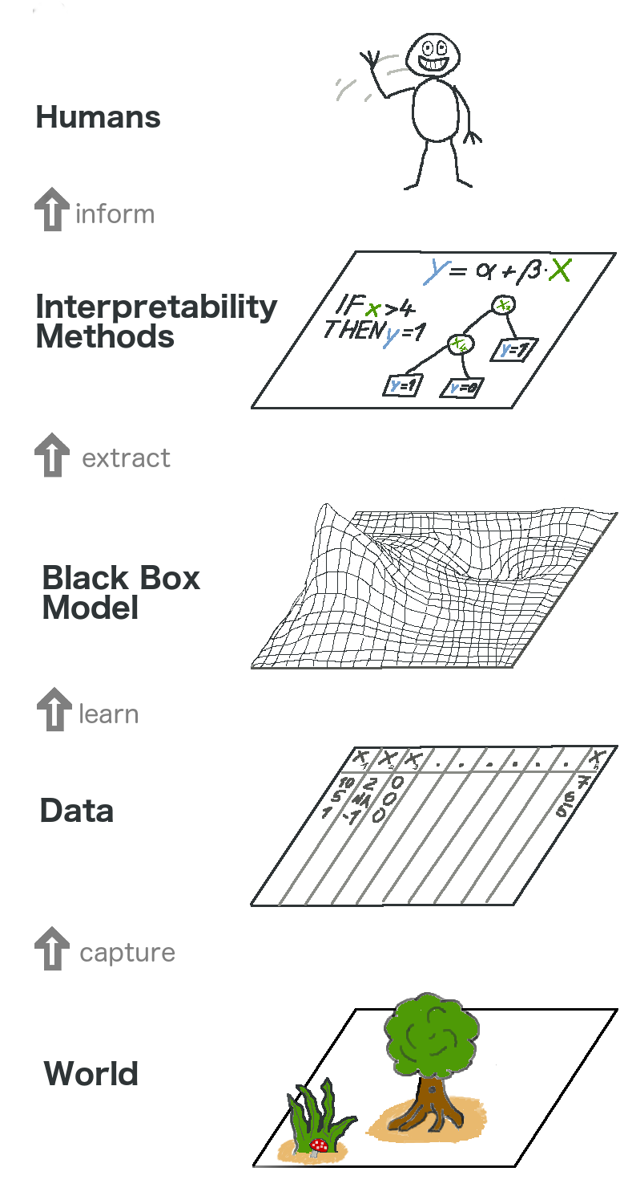
How interpretable are interpretable models?
Domain: Problems in healthcare e.g., risk of mortality have more stringent requirement than retail e.g., placement of ads [Ahmad 2018]
Soundness: An explanation is Sound if it adheres to how the model works [Kuleza 2014]
Completeness: An explanation is Complete if it encompasses the complete extent of the model [Kuleza 2014]
Modality: Until recently most interpretable large predictive time series models were not really interpretable [Schlegel 2019]

Slide 10
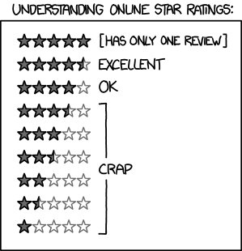



Domain specificity of Interpretations
Describing the trained ML model in terms of domain ontology without using terms that are foreign to the domain where the ML task must be solved [Kovalerchuk, 2020]
The explanations/interpretation has to make sense to the domain expert who is going to use the ML model
The same data may have different meaning in different domains e.g., ratings in Uber vs. Amazon
Notes:
Amazon product vs. Uber

Slide 11
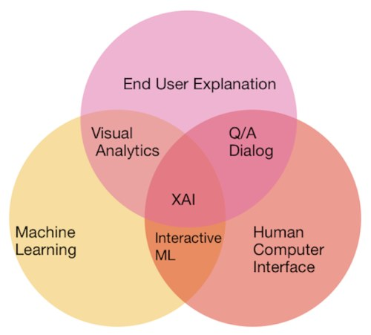
User centricity of Interpretations
Explanations need to be in the right language and in the right context [Doshi-Velez 2014, Druzdzel 1996]
ELI5 Principle: Explain it like I am 5 (years old)
Making domain sense may require sacrificing or deemphasizing model fidelity
Explanations should be role-based - A physician requires different explanations as compared to a staffing planner in a hospital

Slide 12
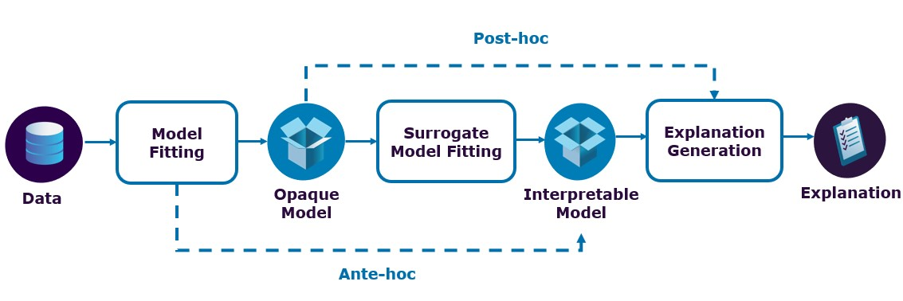
Ante-Hoc vs. Post Hoc Models
Ante-Hoc (Internally Interpreted)
Models where the predictive model and the explanation model is the same
ML model explained in terms of interpreted elements of their structure not only inputs
Post-Hoc (Externally Interpreted)
Models where the predictive model and the explanation model are different
ML model explained in terms of interpretable input data and variables, but without interpreting the model structure

Slide 13
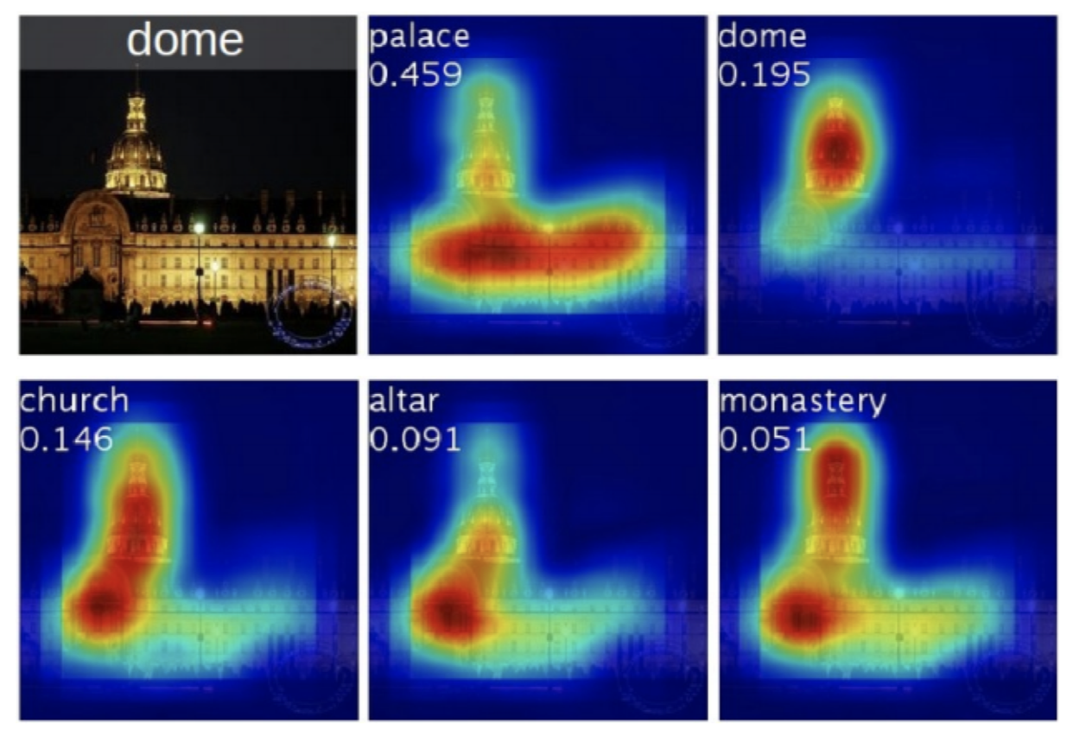
Explicit vs. Implicit Interpretations
Explicit Interpretations
The interpretation is explicitly from the model output
Implicit Interpretations
The interpretation needs to be derived after the application of additional domain knowledge
Decision Trees
Heatmaps

Slide 14
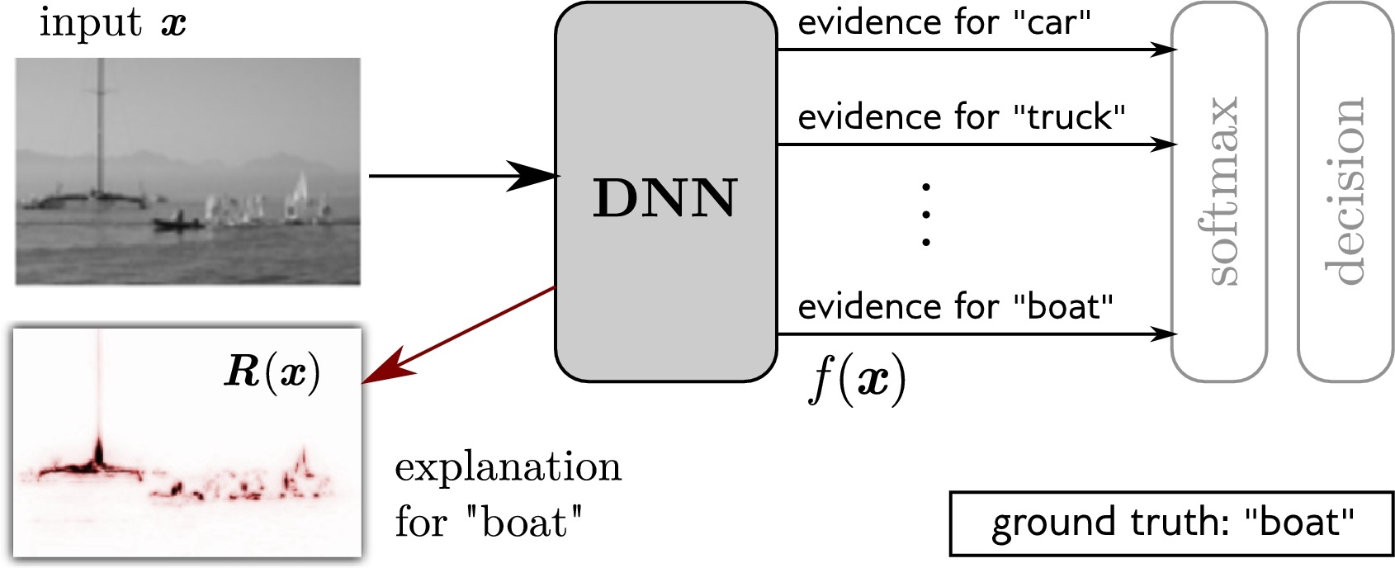
Implicit Explanations
Consider recognizing a boat in an image: Recognize an image as boat based on a group of pixels that look like a mast
This explanation is not applicable to another boat in the same image since that boat has no mast and requires its own explanation. Such conceptual explanations cannot be derived from DNN models
In contrast, in medical imaging, if a radiologist cannot explicitly match DNN dominant pixels with the domain concepts such as tumor, these pixels will not serve as an explanation for the radiologist.

Slide 15
Using black-box models to explain black box models?
The dominant/salient pixels of the image represent the mast as a distinct feature of the boat relative to a car and a truck. This is a result of human knowledge what is a mast that is not explicitly present in the image

Slide 16
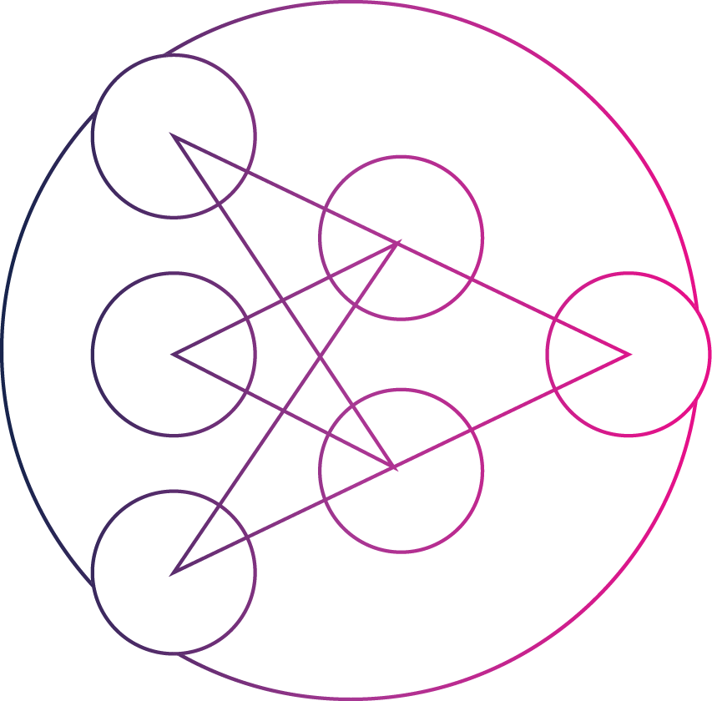




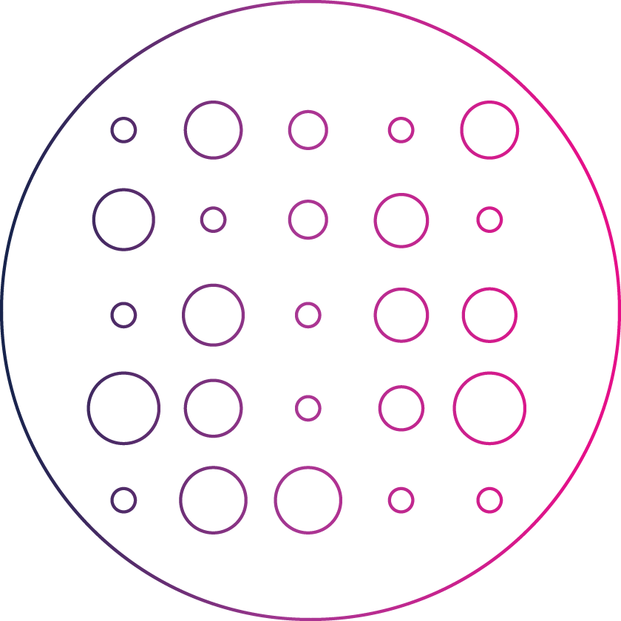



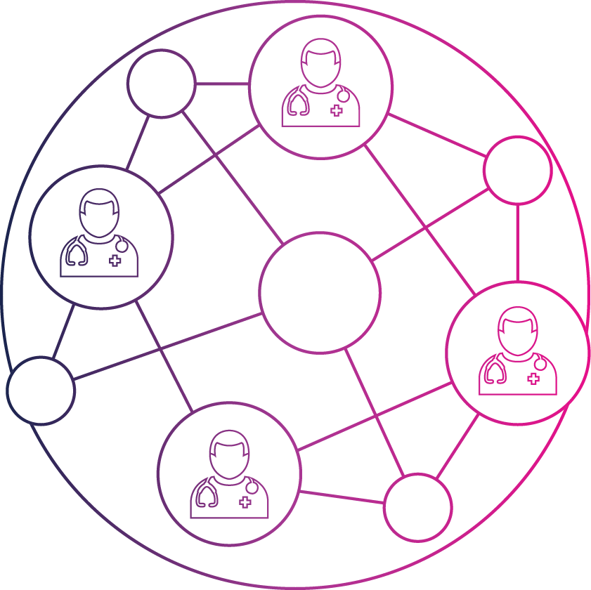
Tutorial Scope
Bayesian Models
Neural Nets
Ensemble Models
Markov Models
Statistical Models
Graphical Models
Reinforcement
Learning
Natural Language
Processing
Expert Systems
Supervised Learning
Recommendation
Systems
[Chang 2009]

Slide 17
Tutorial Scope
Bayesian Models
Neural Nets
Ensemble Models
Markov Models
Statistical Models
Graphical Models
Reinforcement
Learning
Natural Language
Processing
Expert Systems
Supervised Learning
Recommendation
Systems
[Chang 2009]

Slide 18
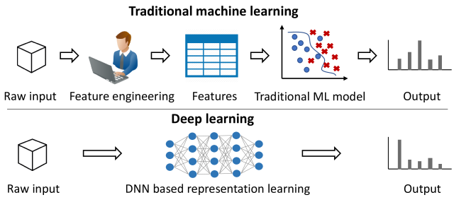
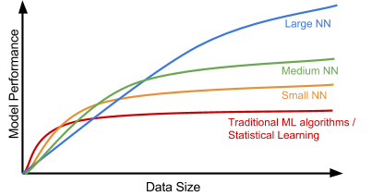
Deep Learning & Explainability

Slide 19
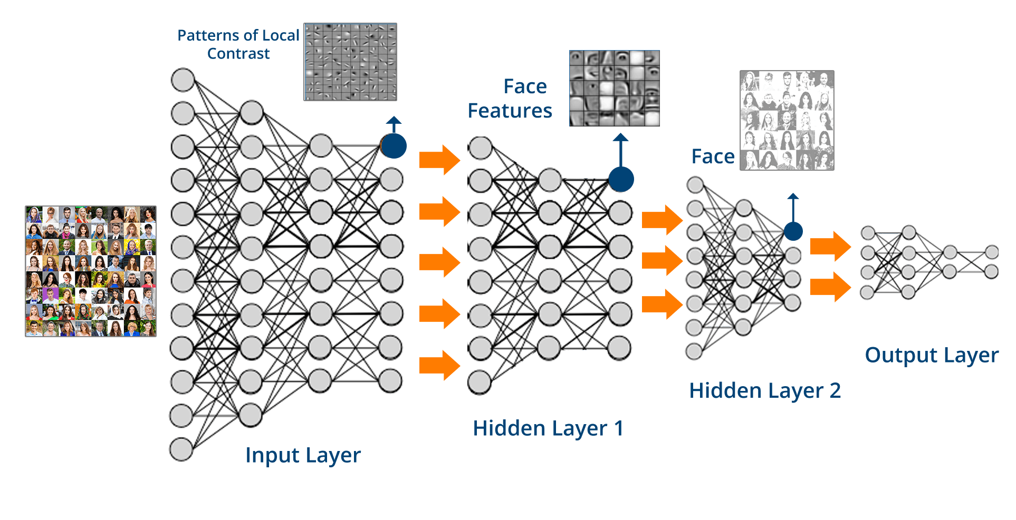
Deep Learning & Explainability

Slide 20
Discovering Visual Interpretable Models

Slide 21
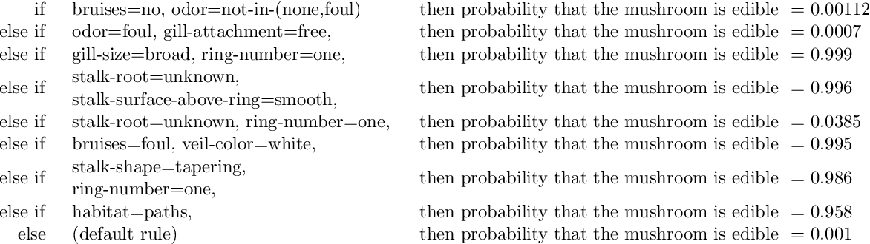
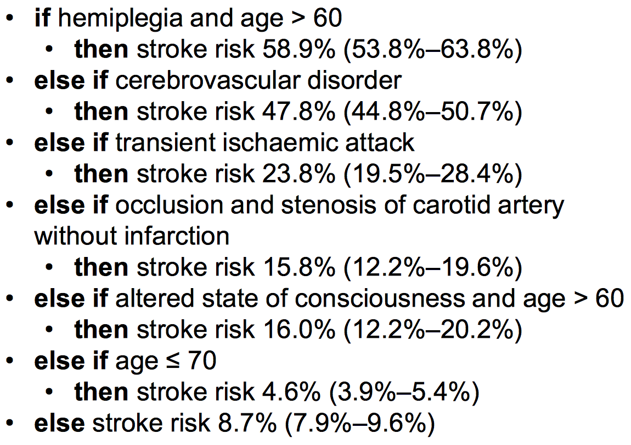
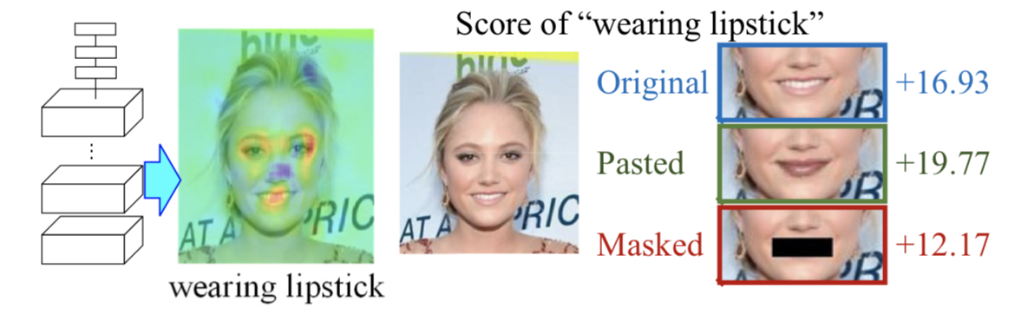
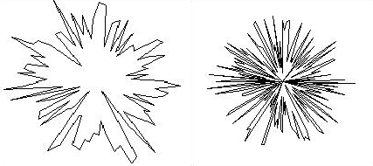




What is visual interpretability?
Non-Visual Methods
[Yang 2017]
Visual Methods
[Letham 2015]
X₅ X₄
X₆ X₇
X₃ X₂
X X
β
9 8
^{X}1^{X}16
^{X}11^{X}10
^{X}15 _{X}
14
^{X}13 ^{X}12

Slide 22
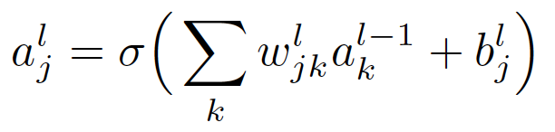
The Allure of Visual Methods
Visual Understanding
Textual Understanding
Understanding the algorithm may not mean be sufficient

Slide 23
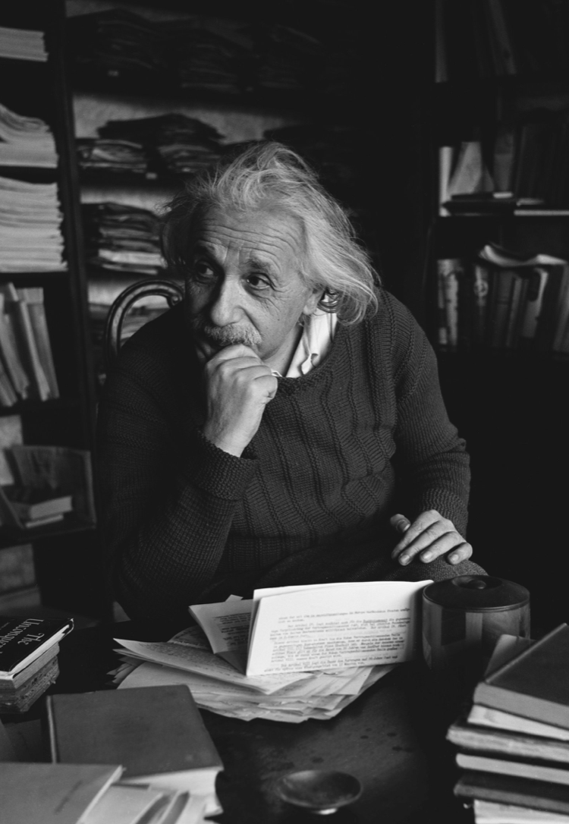
Why Visual Thinking?
A lot of creative thinking is visual
Scientists who declared the fundamental role that images played in their most creative thinking: Bohr, Boltzmann, Einstein, Faraday, Feynman, Heisenberg, Helmholtz, Herschel, Kekule, Maxwell, Poincare, Tesla, Watson, Watt etc.
Albert Einstein: “The words or the language, as they are written or spoken, do not seem to play any role in my mechanism of thought.”
[Thagard & Cameron, 1997; Hadamard, 1954; Shepard & Cooper, 1982]

Slide 24
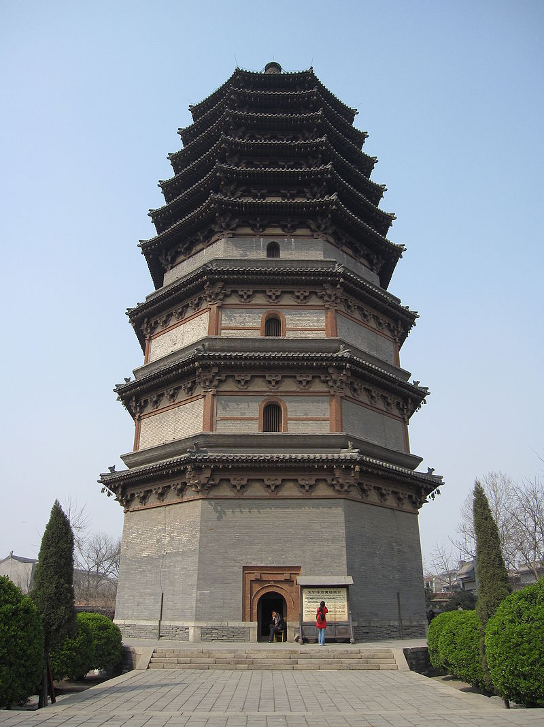
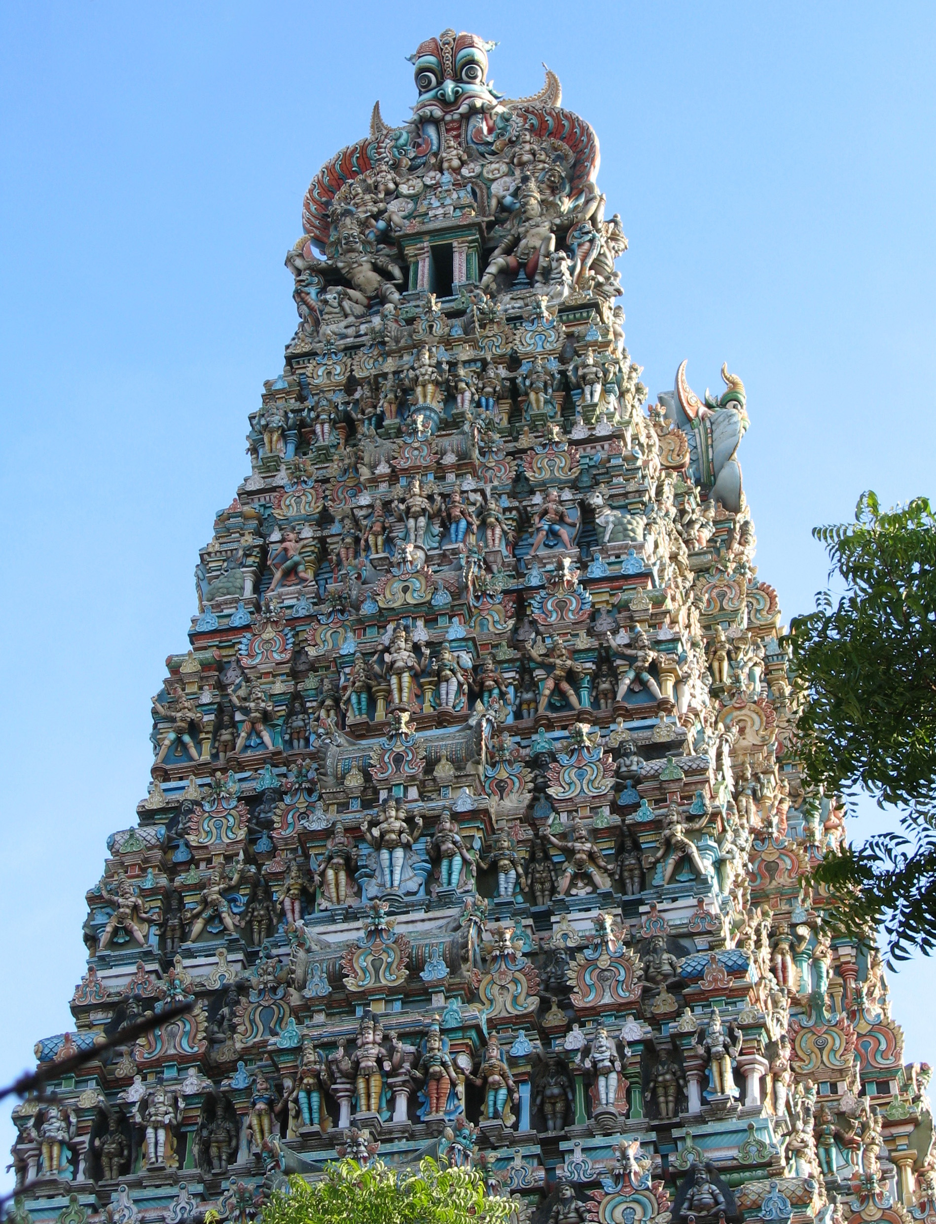
Pre-History of Visual Thinking
Chinese and Indians knew a visual proof of the Pythagorean Theorem in 600 B.C. before it was known to the Greeks [Kulpa 1994]
Madhura Meenakshi Temple
Lingxiao Pagoda of Zhengding

Slide 25
Pre-History of Visual Thinking
(a+b) ² (area of the large square) = a²+b²+ab+ab=(a+b) ²
a²+b²=(a+b) ²(area of the large square) - 2ab (4 light green triangles) = c ² (area of inner darker green square
Thus, we follow this tradition -- moving from visualization of solution to finding solution visually with modern data science tools
a
c
b

Slide 26
Approaches to discovering visual methods
We are moving from visualization of solution to finding solution visually
Why Visual?
To leverage human perceptual capabilities
Why interactive?
To leverage human abilities to adjust tasks on the fly
Why Machine Learning?
To leverage analytical discovery that are outside of human abilities
We cannot see patterns in multidimensional data by a naked eye

Slide 27
Approaches beyond visualization of existing models
Components of approaches:
Visual methods for n-D data representation
Visual methods for model discovery in visual n-D data representations
Methods to interpret visual data representations and models that are not internally interpretable
Visual methods for 2-D/3-D representation of n-D data
Reversible/lossless/interpretable: Parallel Coordinates, Radial Coordinates, General Line Coordinates, Shifted Paired Coordinates, Collocated Paired Coordinates, and others.
Non-reversible/lossy/with challenging interpretation: PCA, MDF, RadVis, Manifolds, t-SNE and others
Notes:
Approaches to discover interpretable ML models boosted by visual means beyond visualization of existing models

Slide 28
What is Visual Discovery?
x | y | class
1 | 0.5 | 1
1.1 | 6 | 2
2 | 1.5 | 1
2.2 | 5 | 2
2.8 | 2.8 | 1
3 | 4 | 2
3.5 | 3.3 | 1
4 | 3.8 | 1
4 | 2.6 | 2
4.5 | 4.7 | 1
5 | 1.8 | 2
5 | 5 | 1
5.5 | 5.5 | 1
6 | 0.8 | 2
What would be the best guess about a line fitting this data?

Slide 29
What is Visual Discovery?
x | y | class
1 | 0.5 | 1
1.1 | 6 | 2
2 | 1.5 | 1
2.2 | 5 | 2
2.8 | 2.8 | 1
3 | 4 | 2
3.5 | 3.3 | 1
4 | 3.8 | 1
4 | 2.6 | 2
4.5 | 4.7 | 1
5 | 1.8 | 2
5 | 5 | 1
5.5 | 5.5 | 1
6 | 0.8 | 2
What would be the best guess about a fitting this data?
A simple linear discrimination function

Slide 30
What is Visual Discovery?
x | y | class
1 | 0.5 | 1
1.1 | 6 | 2
2 | 1.5 | 1
2.2 | 5 | 2
2.8 | 2.8 | 1
3 | 4 | 2
3.5 | 3.3 | 1
4 | 3.8 | 1
4 | 2.6 | 2
4.5 | 4.7 | 1
5 | 1.8 | 2
5 | 5 | 1
5.5 | 5.5 | 1
6 | 0.8 | 2
7
=
6
5
4
3
2
1
0
0
1
2
3
4
5
6
In contrast a quick look at these data, immediately gives a visual insight of a correct model class of “crossing” two linear functions

Slide 31



Visual Discovery in 2-D
7
x | y | class
1 | 0.5 | 1
1.1 | 6 | 2
2 | 1.5 | 1
2.2 | 5 | 2
2.8 | 2.8 | 1
3 | 4 | 2
3.5 | 3.3 | 1
4 | 3.8 | 1
4 | 2.6 | 2
4.5 | 4.7 | 1
5 | 1.8 | 2
5 | 5 | 1
5.5 | 5.5 | 1
6 | 0.8 | 2
6
5
4
=
3
2
1
0
0
1
2
3
4
5
6
7
6
5
4
3
2
1
0
0 1 2 3 4 5 6 7

Slide 32
How to do visual discovery in n-dimensions?
ID | FD1 | FD2 | FD4 | FD5 | FD6 | FD10 | FD12 | FD15 | FD16 | FD18 | FD20 | FD22 | FD23 | FD24 | FD25 | FD26 | FD27 | FD28
1 | 0 | 0 | 2.749807 | 9.826302 | 4.067554 | 0 | 0 | 0 | 5.244006 | 0 | 2.743422 | 0 | 0 | 0 | 0 | 6.254963 | 0 | 0
2 | 11.51334 | 9.092989 | 0 | 12.46223 | 0 | 7.597155 | 0 | 0 | 8.940897 | 0 | 0 | 0 | 4.268456 | 0 | 0 | 0 | 0 | 1.309903
3 | 10.27931 | 0 | 2.075787 | 0 | 4.042145 | 0 | 0 | 0.477713 | 3.97378 | 0 | 0 | 2.477745 | 0 | 0 | 0 | 5.583099 | 0 | 7.418219
4 | 0 | 18.31495 | 0 | 0 | 0 | 0 | 0 | 0 | 4.472742 | 4.671682 | 0 | 7.248355 | 12.11645 | 0 | 0 | 0 | 6.030322 | 0
5 | 14.12261 | 15.1236 | 9.695051 | 0 | 0.915031 | 0 | 0 | 6.086389 | 9.139287 | 0 | 0 | 0 | 8.931774 | 0 | 0 | 0 | 0 | 0
6 | 0 | 0 | 5.405394 | 0 | 0 | 2.951092 | 0 | 3.797284 | 4.576391 | 0 | 0 | 0 | 0 | 0 | 2.763756 | 0 | 0 | 2.562996
7 | 0 | 0 | 0 | 8.068472 | 0 | 3.267916 | 0 | 0 | 5.09157 | 6.082168 | 0 | 0 | 5.42044 | 0 | 0 | 4.431955 | 0.415844 | 2.73227
8 | 6.169271 | 4.918356 | 5.566813 | 0 | 0 | 4.884737 | 5.168666 | 0 | 5.189289 | 0 | 0 | 0 | 2.49011 | 0 | 4.750784 | 2.994664 | 0 | 0
9 | 11.64548 | 0 | 0 | 12.16663 | 0 | 8.407408 | 0 | 0 | 0 | 0 | 0 | 0 | 4.289772 | 0 | 0 | 4.652006 | 0 | 0
10 | 9.957874 | 7.829115 | 0 | 0 | 0 | 0 | 0 | 0 | 7.082694 | 8.388349 | 0 | 0 | 0 | 0 | 0 | 4.706276 | 0 | 0.705345
11 | 9.994487 | 12.3192 | 3.058695 | 0 | 0 | 0 | 6.111047 | 0.380701 | 3.904454 | 0 | 2.573056 | 0 | 0 | 0 | 0 | 5.610187 | 0 | 0
12 | 0 | 8.446147 | 7.506574 | 0 | 0 | 5.846259 | 7.362241 | 6.557457 | 7.627757 | 9.05184 | 0 | 0 | 0 | 0 | 6.646436 | 0 | 0 | 0
13 | 13.65315 | 18.11681 | 2.457055 | 0 | 8.218276 | 0 | 5.689919 | 0 | 4.45029 | 3.213032 | 5.992753 | 0 | 11.56691 | 0 | 0 | 7.734966 | 0 | 0
14 | 0 | 0 | 0 | 8.710629 | 0 | 0 | 0 | 0 | 6.466624 | 0 | 0 | 0 | 3.865449 | 0 | 5.339944 | 3.943355 | 0 | 0
15 | 11.08665 | 0 | 0 | 12.57808 | 0 | 8.377558 | 0 | 9.269582 | 0 | 10.28637 | 0 | 0 | 4.141793 | 0 | 0 | 4.953615 | 0 | 0.433766
16 | 0 | 0 | 7.32989 | 9.848915 | 0 | 0 | 6.639803 | 0 | 0 | 0 | 0 | 0 | 0 | 0 | 0 | 4.288343 | 0 | 0
17 | 0 | 0 | 8.49376 | 0 | 0 | 0 | 7.403671 | 9.346368 | 0 | 0 | 0 | 0 | 0 | 0 | 0 | 0 | 0 | 0
18 | 9.52255 | 0 | 0 | 10.30969 | 0 | 0 | 6.508697 | 0 | 0 | 9.04743 | 0 | 0 | 3.113288 | 0 | 7.667032 | 0 | 0 | 0
19 | 0 | 9.237608 | 3.488988 | 7.443493 | 0 | 0 | 0 | 0 | 0 | 0 | 0.921821 | 1.305681 | 0 | 0 | 0 | 4.447716 | 0 | 4.174564
20 | 0 | 16.78071 | 2.745921 | 0 | 5.606468 | 0 | 7.824948 | 0 | 0 | 4.807075 | 4.454489 | 0 | 0 | 0 | 0 | 7.226364 | 0 | 10.62363
21 | 0 | 0 | 8.18506 | 0 | 0.469365 | 4.241147 | 0 | 5.823779 | 0 | 0 | 0 | 0 | 0 | 0 | 0 | 6.475445 | 0 | 4.49432
22 | 9.609696 | 12.07202 | 0 | 6.483721 | 0 | 0 | 0 | 0 | 0 | 1.554688 | 0 | 5.446015 | 0 | 0 | 0 | 0 | 0 | 9.85667
23 | 10.71318 | 0 | 0 | 11.44685 | 0 | 8.097867 | 0 | 8.832153 | 8.646919 | 0 | 0 | 0 | 0 | 0 | 0 | 4.705225 | 0 | 0
24 | 6.625456 | 0 | 3.686915 | 6.715843 | 0.187058 | 0 | 3.735899 | 3.55698 | 0 | 0 | 0 | 0 | 0 | 0 | 2.996381 | 3.700704 | 0 | 0
25 | 9.794333 | 0 | 0 | 9.788224 | 0 | 4.599581 | 0 | 0 | 0 | 0 | 0 | 0 | 0 | 0 | 0 | 4.694789 | 0 | ⁰10
26 | 10.25995 | 0 | 0 | 9.531824 | 0 | 1.156152 | 6.604298 | 0 | 0 | 0 | 0 | 0 | 6.346496 | 0 | 1.300262 | 0 | 1.869395 | 4.265034
Notes:
In high-dimensions we cannot see data with a naked eye.
We need methods for lossless and interpretable visualization of n-D data in 2-D.

Slide 33
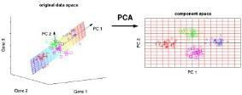
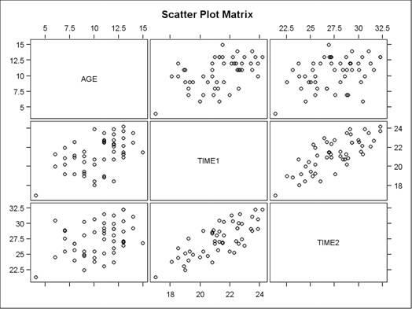
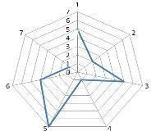
Multi-dimensional data visualization
In high-dimensions one cannot comprehensively see data
Methods for lossless and interpretable visualization of n-D data in 2-D are required
Often multidimensional data are visualized by lossy dimension reduction (e.g., PCA) or by splitting n-D data to a set of low dimensional data (pairwise correlation plots)
While splitting is useful it destroys integrity of n-D data and leads to a shallow understanding complex n-D data
An alternative for deeper understanding of n-D data is visual representations of n-D data in low dimensions without splitting and loss of information is graphs not 2-D points e.g., Parallel and Radial coordinates
Notes:
To mitigate splitting difficulty
an additional and difficult perceptual task of assembling
2-dimensional visualized pieces to the whole n-D record must be solved.

Slide 34
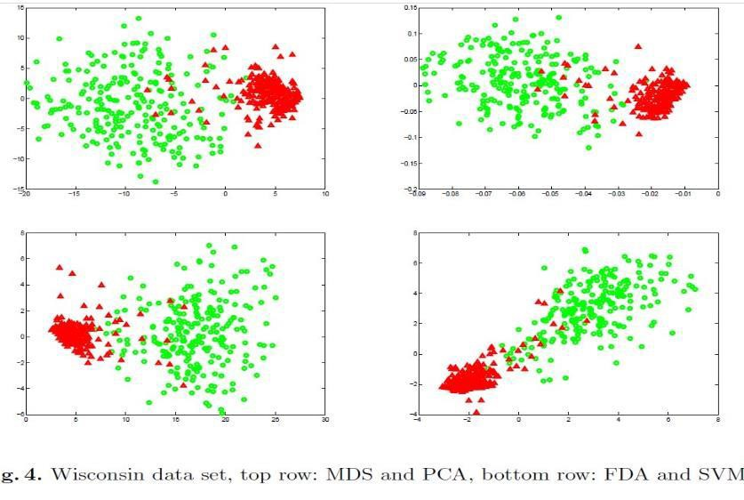
Example: WBC
Benign and malignant cancer cases overlap
Interpretation of dimensions is difficult. Non-reversible lossy methods: 9-D to 2-D
[Maszczyk 2008]

Slide 35
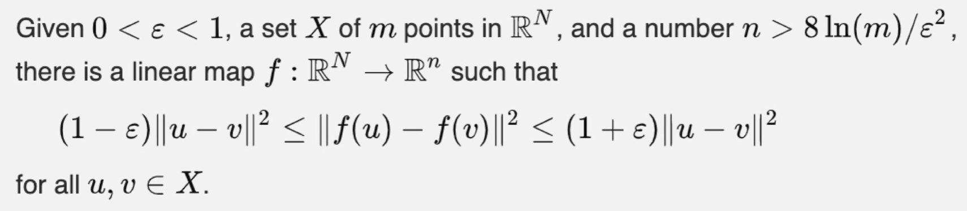
Johnson-Lindenstrauss Lemma
Only a small number of arbitrary n-D points can be mapped to k-D points of a smaller dim k that preserve n-D distances with relatively small deviations
Reason: the 2-D visualization space does not have enough neighbors with equal distances to represent the same n-D distances in 2-D.
Result: the significant corruption of n-D distances in 2-D visualization
Notes:
Johnson-Lindenstrauss Lemma

Slide 36
Different Formulations of the Lemma
Defines the possible dimensions k < n such that for any set of m points in R^{n} there is a mapping f: R^{n} → R^{k} with “similar” distances in R^{n} and R^{k} between mapped points. This similarity is expressed in terms of error 0 < ε < 1.
For ε = 0 these distances are equal. For ε=1 the distances in R^{k} are less or equal to 2 S, where S is the distance in R^{n}. This means that distance s in R^{k} will be in the interval [0, 1.42S].
In other words, the distances will not be more than 142% of the original distance, i.e., it will not be much exaggerated. However, it can dramatically diminish to 0
[Dasgupta 2003]

Slide 37
Theoretical limits: Preserve n-D in 2-D
Johnson-Lindenstrauss Lemma shows that to keep distance errors within about 30% for just 10 arbitrary high-dimensional points, we need over 1,900 dimensions, and over 4,500 dimensions for 300 arbitrary points
Visualization methods do not meet these requirements
Number of arbitrary points in high- dimensional space | Sufficient dimension with formula (3.1) | Sufficient dimension with formula (3.2)_ | Insufficient dimension with formula (3.3)
10 | 1974 | 2145 | 1842
20 | 2568 | 2791 | 2397
30 | 2915 | 3168 | 2721
40 | 3162 | 3436 | 2951
50 | 3353 | 3644 | 3130
60 | 3509 | 3813 | 3275
70 | 3642 | 3957 | 3399
80 | 3756 | 4081 | 3506
90 | 3857 | 4191 | 3600
100 | 3947 | 4289 | 3684
200 | 4541 | 4934 | 4239
300 | 4889 | 5312 | 4563
Dimensions to support ±31% of error (ε=0.1).
16000
14000
12000
10000
8000
6000
4000
2000
0
10 20 30 40 50 60 70 80 90 100 200 300
Dimensions required supporting ± 31% of error ε.

Slide 38
New Lossless GLC Approaches, Algorithms & Case Studies

Slide 39
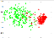


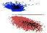

Approaches to Convert n-D data to 2-D data
Lossy approach
Lossy conversion to 2-D (dimension reduction, DR)
Point to point (n-D point to 2-D point)
Visualization in 2-D
Interactive discovery of 2-D patterns in visualization
Lossless approach
Lossless conversion (visualization) to 2-D (n-D data fully restorable from its visualization)
Interactive discovery of 2-D patterns on graphs in visualization
n-D data
2-D data &
2-D patterns
n-D data and n-D patterns
2-D data & n-D patterns
Notes:
Point to graph (n-D point to graph in 2-D), e.g., (5,4,0,6,5,10) to a graph

Slide 40

















GLC-L Algorithms for Visualization
Given: 4-D point (x₁, x₂,x₃, x₄ )=(1,0.8, 1.2, 1)
Algorithm
4 coordinate lines at different angles Q₁-Q₄
Values shown as blue lines (vectors)
Shifting and stacking blue lines
Projecting the last point to U line
Do the same for other 4-D points of blue class
Do the same for 4-D points of red class
Optimize angles Q₁-Q₄ to separate classes (yellow line)
1
Q₁
1.2
X₁
0.8
X
X₃
X₄
1
2
Q₂
Q₃
Q
4
x₄
x₃
x₂
x₁
X₂
X₃
X₄
Q₁
Q₂
Q₃
Q₄
Notes:
General Line Coordinates

Slide 41








GLC-L Algorithms for Visualization
1
Q₁
X₁
X₃
1.2
X₄
1
0.8
X
2
Q₂
Q₃
Q
4
x₄
x₃
x₂
x₁
X₂
X₃
X₄
Q₁
Q₂
Q₃
Q₄

Slide 42
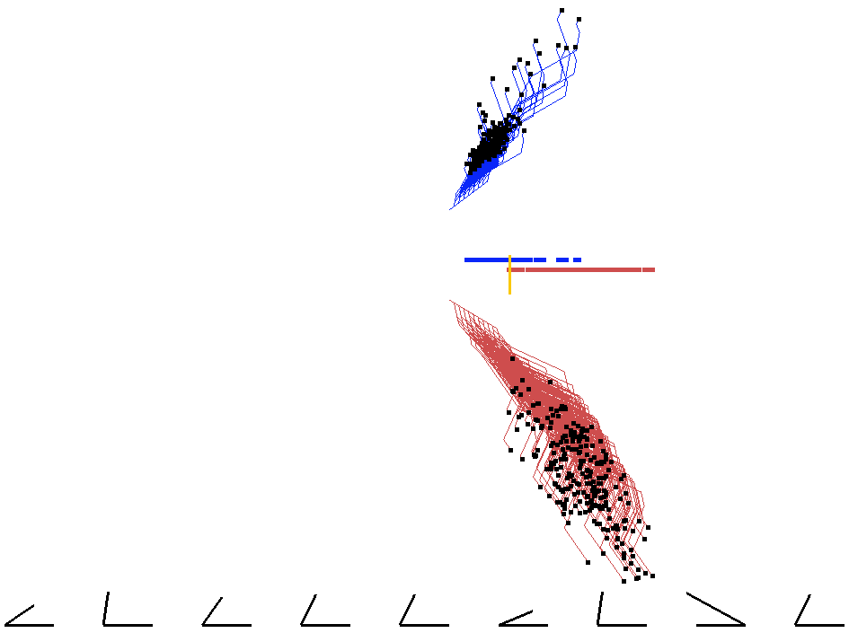
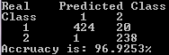
9-D Wisconsin Breast Cancer
444 benign (blue) cases
Critical in Medical diagnostics and many other fields
Explanation of patterns and understanding patterns
Lossless visual means Reversible/restorable
Only one malignant (red case) on the wrong side
239 malignant (red) cases
Notes:
Visual linear discrimination of 9-D Wisconsin Breast Cancer data in GLC-L coordinates

Slide 43
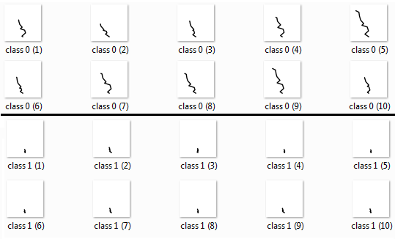

Avoiding Occlusion with Deep Learning on WBC data
Numeric 9-DWisconsin
Breast Cancer (WBC) Data
Visualized numeric data as downscaled
25x25 pixels images using GLC-L method
Deep Learning
Convolutional Neural Network (CNN) on images (GLC-L visualization) as input
WBC data samples visualized in GLC-L for CNN model with the best accuracy.
Classification accuracy 97.22%
at the level and above published in literature
Visualization
optimization

Slide 44
















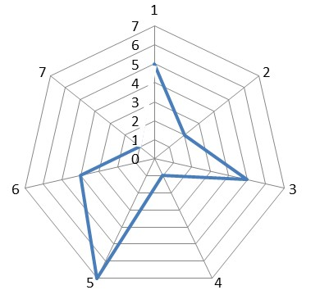
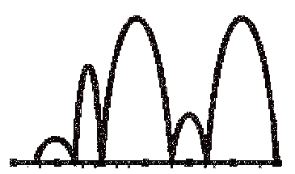




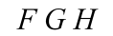



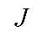
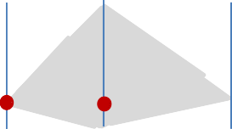
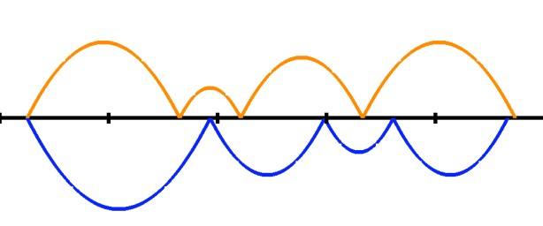
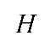


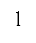




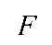
General Line Coordinates
X₁
X₂
X₃ X₄ X₅ X₆
(a) 7-D point D in General Line Coordinates with straight lines.
X₇
X₁
X₂ X₃ X₄ X₅ X₆ X₇
7-D point D=(5,2,5,1,7,4,1) in Parallel Coordinates
X₁ X₂ X₃ X₄ X₅ X₆ X₇
(b) 7-D point D in General Line Coordinates with curvilinear
lines.
X₁ X₂ X₃ X₄ X₅ X₆
6-D (5,4,0,6,4,10) point in
In-line Coordinates
(c) 7-D points F-J in General Line Coordinates that form a
simple single straight line.
.
7-D point D=(5,2,5,1,7,4,1) in
Radial Coordinates.
(d) 7-D points F-J in Parallel Coordinates that do not form a
simple single straight line.
7-D points in General Line Coordinates with different directions of coordinates X1,X2,…,X7 in comparison with Parallel Coordinates.
Two 5-D points of two classes in Sequential In-Line Coordinates.
Notes:
GLC coordinates can be of different length, curvilinear, connected or disconnected, and oriented to any direction

Slide 45













































































General Line Coordinates
0.0
X₁
(a) Parallel Coordinates display.
(b) Circular Coordinates display.
X₆
0.5
0.1
1.0
X₆ X₄ 0.2
0.3 X₁
0.0
X
2
0.6
X₅
0.7
X
0.6
X
X₁
0.4
3
X
4
0.5
0.5
2
X₃
^{X4} 0.7
X
0.2
X₂
X₅
0.9
3
0.3
n-Gon (rectangular) coordinates with 6-D point (0.5, 0.6, 0.9, 0.7,
0.7, 0.1).
(c) Spatially distributed objects in circular coordinates with two coordinates X₅ and X₆ used as a location in 2-D and X₇ is encoded by the sizes of circles.
Figure 2.5. Examples of circular coordinates in comparison with parallel coordinates.
(a) Point A in in 3-Gon coordi- nates.
(b) Point A in in radial coordi- nates.
100
X₃ Wednesday
0
100
X₃ Wednesday
0
3-D point A=(0.3, 0.7, 0.4) in 3-Gon (triangular) coordinates and in radial coordinates.
(a) Example in n-Gon coordinates with curvi- linear edges of a graph.
(b) Example in n-Gon coordinates with straight edges of a graph.
Figure 2.6 Example of weekly stock data in n-Gon (pen4tag5on) coordinates.
Notes:
https://link.springer.com/chapter/10.1007/978-3-319-73040-0_2

Slide 46
General Line Coordinates (GLC): 2-D
Type | Characteristics
2-D General Line Coor- dinates (GLC) | Drawing n coordinate axes in 2-D in variety of ways: curved, parallel, unparal- leled, collocated, disconnected, etc.
Collocated Paired Coor- dinates (CPC) | Splitting an n-D point x into pairs of its coordinates (x1,x2),…,(xn-1,xn); drawing each pair as a 2-D point in the collocated axes; and linking these points to form a directed graph. For odd n coordinate Xn is repeated to make n even.
Basic Shifted Paired Coordinates (SPC) | Drawing each next pair in the shifted coordinate system by adding (1,1) to the second pair, (2,2) to the third pair, (i-1, i-1) to the i-th pair, and so on. More generally, shifts can be a function of some parameters.
2-D Anchored Paired Coordinates (APC) | Drawing each next pair in the shifted coordinate system, i.e., coordinates shift- ed to the location of a given pair (anchor), e.g., the first pair of a given n-D point. Pairs are shown relative to the anchor easing the comparison with it.
2-D Partially Collocated Coordinates (PCC) | Drawing some coordinate axes in 2D collocated and some coordinates not col- located.
In-Line Coordinates (ILC) | Drawing all coordinate axes in 2D located one after another on a single straight line.
Circular and n-Gon coordinates | Drawing all coordinate axes in 2D located on a circle or an n-Gon one after another.
Elliptic coordinates | Drawing all coordinate axes in 2D located on ellipses.
GLC for linear functions (GLC-L) | Drawing all coordinates in 2D dynamically depending on coefficients of the linear function and value of n attributes.
Paired Crown Coordi- nates (PWC) | Drawing odd coordinates collocated on the closed convex hull in 2-D and even coordinates orthogonal to them as a function of the odd coordinate.

Slide 47
General Line Coordinates (GLC): 3-D
Type | Characteristics
3-D General Line Co- ordinates (GLC) | Drawing n coordinate axes in 3-D in variety of ways: curved, parallel, unparal- leled, collocated, disconnected, etc.
Collocated Tripled Co- ordinates (CTC) | Splitting n coordinates into triples and representing each triple as 3-D point in the same three axes; and linking these points to form a directed graph. If n mod 3 is not 0 then repeat the last coordinate Xn one or two times to make it 0.
Basic Shifted Tripled Coordinates (STC) | Drawing each next triple in the shifted coordinate system by adding (1,1,1) to the second tripple, (2,2,2) to the third tripple (i-1, i-1,i-1) to the i-th triple, and so on. More generally, shifts can be a function of some parameters.
Anchored Tripled Coordinates (ATC) in 3-D | Drawing each next triple in the shifted coordinate system, i.e., coordinates shifted to the location of the given triple of (anchor), e.g., the first triple of a given n-D point. Triple are shown relative to the anchor easing the comparison with it.
3-D Partially Collocated Coordinates (PCC) | Drawing some coordinate axes in 3-D collocated and some coordinates not collo- cated.
3-D In-Line Coordinates (ILC) | Drawing all coordinate axes in 3D located one after another on a single straight line.
In-Plane Coordinates (IPC) | Drawing all coordinate axes in 3D located on a single plane (2-D GLC embedded to 3-D).
Spherical and polyhedron coordinates | Drawing all coordinate axes in 3D located on a sphere or a polyhedron.
Ellipsoidal coordinates | Drawing all coordinate axes in 3D located on ellipsoids.
GLC for linear func- tions (GLC-L) | Drawing all coordinates in 3D dynamically depending on coefficients of the linear function and value of n attributes.
Paired Crown Coordi- nates (PWC) | Drawing odd coordinates collocated on the closed convex hull in 3-D and even coordinates orthogonal to them as a function of the odd coordinate value.

Slide 48




Reversible Lossless Paired Coordinates
Y
X
(a) Collocated Paired Coordinates (b) Shifted Paired Coordinates.
.
6-D point (5,4,0,6,4,10) in Paired Coordinates.
(a) Collocated Paired Coordinates
(b) Parallel Coordinates
6-D point x=(x,y,x`,y`,x``,y``)=(0.2, 0.4, 0.1, 0.6, 0.4, 0.8) in Anchored Paired Coordinates with numbered arrows.
State vector x = (x,y,x`,y`,x``,y``) = (0.2, 0.4, 0.1, 0.6, 0.4, 0.8) in Collocated Paired and Parallel Coordinates.
Notes:
We use an example in 6-D with a state vector x = (x, y, x′, y′, x′′, y′′), where x and y are location of the object, x′ and y′ are velocities (first derivatives), and x′′ and y′′ are accelerations (second derivatives) of this object.
The main steps of the algorithm are:
Normalization of all dimensions to the same interval, e.g., [0, 1],
Grouping attributes into consecutive pairs (x, y) (x′, y′′) (x′′, y′′),
Plotting each pair in the same orthogonal normalized Cartesian coordinates X
and Y, and
Plotting a directed graph (digraph): (x, y) ! (x′, y′) ! (x′′, y′′) with directed
edges (arrows) from (x, y) to (x′, y′) and from (x′, y′) to (x′′, y′′).

Slide 49
























Reversible lossless Paired Coordinates
X₅ X₄
X₆ X₇
X₃ X₂
X X
β
9 8
^{X}1^{X}16
^{X}11^{X}10
^{X}15 _{X}
14
X
^{X}13 ^{X}12
X
3
(x₃,x₄)
=(2,2)
2
(a) (b) (c)
2
(1,1)= (x ,x )
n-D points as closed contours in 2-D: (a) 16-D point (1,1,2,2,1,1,2, 2,1,1,2,2,1,1,2,2) in Partially Collocated Radial Coordinates with Cartesian encoding, (b) CPC star of a 192-D point in Polar encoding,
(c) the same 192-D point as a traditional star in Polar encoding.
1 2
1
X
1 2
1
X
6
X
(1,1)= (x₅,x₆)
M
4 X
5
X₄
6-D point as a closed contour in 2-D where a 6-D point x=(1,1, 2,2,1,1) is forming a tringle from the edges of the graph in Paired Radial Coordinates with non-orthogonal Cartesian mapping.
C_{E}
X₁
0.2
0.3
B
A
X₃
X₂
0.5
0.5
4-D point P=(0.3,0.5,0.5,0.2) ) in 4-D Elliptic Paired Coordinates, EPC-H as a green arrow. Red marks separate coordinates in the Coordinate ellipse.
6-D point (1, 1, 1, 1, 1, 1) in two X1-X6 coordinate systems (left – in Radial Collocated Coordinates, right – in Cartesian Collocated Coordinates).
49
4-D point P=(0.3,0.5,0.5,0.2) ) in Radial Coordinates.

Slide 50























































Graph construction algorithms in GLC
Six coordinates and six vectors that represent a 6-D data point (0.75,0.5,0.7,0.6,0.7, 0.3)
6-D data point (0.75,0.5,0.7,0.6,0.7, 0.3) in GLC-CC1
6-D data point (0.75,0.5,0.7,0.6,0.7, 0.3) in GLC-PC.
6-D data point (0.75,0.5,0.7,0.6,0.7, 0.3) in GLC-CC2
X ₆
x₁
x₂
X _{3 X}
4
x₃
x₅
x₆
x₄
X ₁
X ₂
X ₅
6-D data point (0.75,0.5,0.7,0.6,0.7, 0.3) in GLC-SC1. 6-D data point (0.75,0.5,0.7,0.6,0.7, 0.3) in GLC-SC2

Slide 51
Math, theory and pattern simplification methodology: Statements
Statement 1. Parallel Coordinates, CPC and SPC preserve L^{p} distances for p=1 and p=2, D(x,y) = D*(x*,y*).
Statement 2 (n points lossless representation). If all coordinates X_{i} do not overlap then GLC-PC algorithm provides bijective 1:1 mapping of any n-D point x to 2-D directed graph x*.
Statement 3 (n points lossless representation). If all coordinates X_{i} do not overlap then GLC-PC and GLC-SC1 algorithms provide bijective 1:1 mapping of any n-D point x to 2-D directed graph x*.
Statement 4 (n/2 points lossless representation). If coordinates X_{i}, and X_{i+1} are not collinear in each pair (X_{i}, X_{i+1}) then GLC-CC1 algorithm provides bijective 1:1 mapping of any n-D point x to 2-D directed graph x* with ⬆n/2 nodes and ⬆n/2 - 1 edges.
Statement 5 (n/2 points lossless representation). If coordinates X_{i}, and X_{i+1} are not collinear in each pair (X_{i}, X_{i+1}) then GLC-CC2 algorithm provides bijective 1:1 mapping of any n-D point x to 2-D directed graph x* with ⬆n/2 nodes and ⬆n/2 - 1 edges.

Slide 52














































Adjustable GLCs for decreasing occlusion and pattern simplification
X`₁
X`₅
X`₆ X`₄ X`₃
X`₂
3
2
(a) Data in Parallel Coor- dinates – non-preattentive
representation.
(b) Data in the Shifted Par- allel Coordinates - preatten-
tive representation.
1
0
X₁
X₂ X₃ X₄
X₅
X₆
(a) Original visual rep- resentation of the two classes in the Parallel
Coordinates,
(b)Simplified visual rep- resentation after the shifting and reordering of the Paral-
lel Coordinates.
Simplification of the visual representation by the shifting and reordering of the Parallel Coordinates
Non-preattentive vs. preattentive visualizations (linearized patterns): 6-D point A= (3, 6, 4, 8, 2, 9) in blue, and 6-D point B=(3.5, 6.8, 4.8, 8.5, 2.8, 9.8) in orange in Traditional, Shifted Parallel Coordinates, and GLC
(c) Data in the Shifted General Line Coordinates- preattentive representation.
(d) Data in the scaled Paral- lel Coordinates – preatten- tive representation

Slide 53



















2 4
Case Studies: World Hunger data
4-D data: representation of prevalence of under- nourished in the population (%) in
Collocated Paired Coordinates
4-D data: representation of prevalence of undernourished in the population (%) in traditional time series (equivalent to Parallel Coordinates for time series)
The Global Hunger Index (GHI) for each country measures as,
GHI = (UNN+UW5+MR5)/3,
where UNN is the proportion of the population that is Undernourished (in %), UW5 is the prevalence of Underweight in children under age of five (in %), and MR5 is the Mortality rate of Children under age five (in %).

Slide 54









Case Studies: Health Monitoring with PC and CPC
Total cholesterol
120 140 160 180 200 220 240 260
60 80 100 120 140 160 180
diastolic
Dark green dot – goal.
Yellow and light green -- closer to the goal point.
Red arrow -- initial health status.
Experiments -- people quickly grasp how to use this health monitor.
This health monitor is expandable.
Two more indicators is another pair of shifted Cartesian Coordinates.
(100, 150, 95, 250)
( 93, 147, 95, 230)
( 80, 127, 68, 200)
(70, 120, 60, 190)
systolic
pulse
40 50 60 70 80 90 100 110
a) PSPC: The green dot is the desired goal state, the red arrow is the initial state, the orange arrow is the health state at the next moni- toring time, and the light green ar-
row is the current health state of the person.
(b) the same data as in (a) in Parallel
Coordinates.
The goal is the same dark green 2-D dot
Each graph has two connected arrows.
4-D Health monitoring visualization in PSPC (a) and
Parallel Coordinates (b) with parameters: systolic blood
Graphs closer to the goal are smaller.
pressure, diastolic blood pressure, pulse, and total choles- terol at four time moments.

Slide 55




Lossless Visualization of 48-D and 96-D data
Two stars with identical shape fragments on intervals [a,b] and [d,c] of coordinates.
Samples of some class features on Stars for n=48.
Samples of some class features on PCs for n=48
Visual Patterns-- combinations of attributes
Examples of corresponding figures: stars (row 1) and PCs lines
(row 2) for five
Notes:
Lossless Visualization of 48-D and 96-D data in CPC-Stars, Radial Stars and Parallel Coordinates

Slide 56





Discovering high- dimensional interpretable patterns in
160-Dimensions!
Twenty 160-D points of 2 classes represented in Radial Coordinates with noise 10% of max value of normalized coordinates (max=1) and
with standard deviation 20% of each normalized coordinate.
Twenty 160-D points of 2 classes represented in star CPC with noise 10% of max value of normalized coordinates (max=1) and with standard deviation 20% of each normalized coordinate.
Twenty 160-D points of 2 classes represented in Parallel Coordinates with noise 10% of max value of normalized coordinates (max=1) and with standard deviation 20% of each normalized coordinate
(a) Initial 100-D points without noise for Class (Hyper-tube) #1 and Class (Hyper-tube) #2
(b) 100-D points with multiplicative noise: circled areas are the same as in upper star.
Figure 6.10. Samples of 100-D data in Star CPC used to make participants familiar with the task.

Slide 57


Human abilities to discover patterns in high-D data
The expected classifiable dimensions are in [160,192] interval for the Radial Coordinates
Due to advantages of Star CPC over Radial Coordinates, these limits must be higher for Star CPC and lower for Parallel Coordinates
Finding bounds for linear-hyper-tubes most likely will be also limits for non-linear hyper-tubes due to their higher complexity
Traditional 170-D stars: class “musk” (first row) and class “non-musk chemicals” (second row). CPC 170-D stars from the same dataset: class “musk” (third row) and class “non-musk chemicals” (forth row).
Nine 170-dimensional points of two classes in Parallel Coordinates
Notes:
The experiment with n=192 and a high level of noise (30%) points out on the likely upper bound of human classification of n-D data using the Radial Coordinates for data modeled as linear hyper-tubes
The experiment with n-160 shows that the upper bound for human classification on such n-D data is no less than n=160 dimensions with up to 20% noise.
Thus the expected classifiable dimensions are in [160,192]
dimensions interval for the Radial Coordinates.
Due to advantages of Star CPC over Radial Coordinates, these limits must be higher for Star CPC and lower for Parallel Coordinates due to higher occlusion in PC. L
More exact limits are the subject of the future experiments. About 70 respondents participated in the experiment with 160- D, therefore it seems that 160 dimensions can be viewed as a quite firm bound.
In contrast, the question that 192-D is the max of the upper limit for Star CPC may need addition studies.
Thus, so far the indications are that the upper limit for Star CPC is above n=192 and it needs to be found in future experiments for linear hyper-tubes. Finding bounds for linear-hyper-tubes most likely will be also limits for non-linear hyper-tubes due to their higher complexity.

Slide 58
Lossy & Traditional Methods & Case Studies

Slide 59

Lossy Methods Revisited: PCA
Account for variance of data in as few dimensions as possible (using linear projection)
First PC is the projection direction that maximizes the variance of the projected data
Second PC is the projection direction that is orthogonal to the first PC and maximizes variance of the projected data

Slide 60


PCA can occasionally fail
Angle has the most information but this is not captured by the basis
Sometimes most important information is not orthogonal

Slide 61


Lossy Methods Revisited: t-SNE
Visualizes high-dimensional data in a 2- or 3-dimensional map
Better than most techniques at creating a single map that reveals structure at many different scales
Particularly good for high-dimensional data that lie on several different, but related, low-dimensional manifolds.
Example: images of objects from multiple classes seen from multiple viewpoints.

Slide 62

Lossy Visualization
(a) PCA, first two principal components
(b) first three principal components, 3D PCA.
(c) 2D and (d) 3D visualization of the nonlinear reduction mapping using t-SNE
(e) 2D and (f) 3D visualization of the nonlinear mapping using Laplacian eigenmaps

Slide 63
Lossy Visualization in ML Models
Methods like T-SNE, PCA and others do not preserve all information of initial features (they are lossy visualizations of n-D data)
They convert n interpretable features to 2-3 artificial features that have no direct interpretation
General Line Coordinates is an alternative that preserves all n-D information when occlusion/clutter in visualization is suppressed that was successfully done in [Kovalerchuk 2014-2019]

Slide 64

Do PCA and t-SNE actually reveal multi-dimensional relationships?
MNIST is visualized in t-SNE as clusters colored by their associated digit labels so that “those images with high similarity in their original feature space are placed close to each other in the 2D/3D space
“one can easily identify and which digit images are outliers (and thus confusing as another digit)”
t-SNE author Maaten warned about such statements-- t-SNE may not assign meaning, to point densities, in clusters. The outlier and dense areas, visible in t-SNE, may not be them, in the original n-D space
In addition, the 2–D attributes, generated by t-SNE, do not have direct domain interpretation

Slide 65

Interpreting Time Series via Reversible Methods
Trends in retrospective time series data are relatively straightforward to understand
How do we understand predictions of time series in data?

Slide 66

Interpreting Time Series via Reversible Methods
Similar to the saliency masks on images, a heatmap can be created based on the relevance produced by XAI methods
Create a visualization with this heatmap enriching a line plot of the original time series. Together with domain knowledge, an expert can inspect the produced explanation visualizations
[Schlegel 2019]

Slide 67



Visualizing Association Rules
Matrix with rows as Left Hand Side, LHS itemsets of rules and columns as Right Hand side (RHS) itemsets of rules
Scalability for many LHS and RHS
Readability of small cells having many items
Image source: sklearn

Slide 68

(Ahmad et al 2018)

Slide 69


Visualizing ARules using Parallel Sets
Before
Approach:
Discovering Association Rules
Deleting dimensions irrelevant to AR
Feeding rules to two coordinated rule visualizations (called ARTable and ParSets)
User interactions
Visually explore rules in ARTable
Find interesting rules, dimensions, and categories in ARTable
Create and optimize the layout of ParSets
Validate interesting rules
Explore details of rules in ParSets using domain knowledge
After
Source Visualization
Notes:
ParSets displays dimensions as adjacent parallel axes and their values (categories) as segments over the axes (points in Parallel Coordinates [Inselberg, 2009]). Connections between categories in the parallel axes form ribbons (lines in parallel coordinates). The ribbon crossings lead to visual clutter.
Titanic example: Clutter 16.86% -- alphabetical ordering of dimensions and categories.
Clutter 11.71% --ordering by the number of grades (categories) in each coordinate.

Slide 70




Folded Coordinate Decision Tree (FC-DT)
(a) Traditional visualization of WBC data decision tree. Green edges and nodes in- dicate the benign class and red edges and nodes indicate the malignant class.
(b) DT with edges as Folded Coordinates in disproportional scales. The curved lines are cases that reach the DT malignant edge with different certainties due to the different dis- tances from the threshold node.
Notes:
(a) A traditional DT visualization for 9-D Wisconsin Breast Cancer (WBC) data clearly presents the structure of the DT model, but without explicitly tracing individual cases.
(b) The tracing is added with a dotted polyline. It
shows two 5-D points a= (2.8, 5, 2.5, 5.5, 6.5) and
b= (5, 8, 3, 4, 6).
– Both points reach the terminal malignant edge of the DT, but with different certainty. The first point reaches it with lower certainty, having its values closer to the thresholds of coordinates denoted as uc and bn.
In this visualization, called Folded Coordinate Decision Tree (FC-DT) visualization, the edges of the DT not only connect decision nodes, but also serve as Folded Coordinates in disproportional scales for WBC data.
Here, each coordinate is folded at the node threshold point with different lengths of the sides.
For instance, with threshold T=2.5 on the coordinate uc with the interval of values [1,10], the left interval is [1, 2.5) and the right interval is [2.5,10]. In Figure b, these two unequal intervals are visualized with equal lengths, i.e., forming a disproportional scale.

Slide 71


iForest: Interpreting Random Forests via Visual Analytics
Making sense of Random Forests

Slide 72

iForest

Slide 73

TreeExplainer for Tree Based Models
The polynomial time algorithm to compute optimal explanations based on game theory
An explanation that directly measures local feature interaction effects. Tools for understanding global model structure based on combining local explanations of each prediction
TreeExplainer matches human intuition across a benchmark of 12 user study scenarios
Simple visualization with Local explanations based on
TreeExplainer to understand global model structure
[Lundberg et al 2019]

Slide 74

Rule Matrix
RuleMatrix: Visualizing and Understanding Classifiers using Rules

Slide 75
Brief overview of Visualization Methods in Deep Learning
Part I

Slide 76
Understanding Deep Learning via Generalization Analysis
Empirical observations
Convolutional networks for image classification trained with stochastic gradient methods easily fit a random labeling of the training data
It occurs even after replacing the true images by completely unstructured random noise
Here the learning must be impossible and should show up during training, e.g., by not converging or slowing down
Theoretical results
Large neural networks can express any labeling of the training data
Theorem: There exists a two-layer neural network with 2n+d weights that can represent any function on a sample of size n in d dimensions
These models are in principle rich enough to memorize the training data
Notes:
This theorem is for a finite sample of size n in contrast the NN universal approximation theorems are for the entire domain.

Slide 77

Understanding Deep Learning via Generalization Analysis
Explanation for such accurate models by known heatmap activation methods can be constructed, but what will be its value?
To distinguish it from a meaningful explanation we need to analyze the generalization process and errors beyond training data
How to distinguish between the models trained on the true labels that are potentially explainable and models trained on random labels (high generalization error) that should not be meaningfully explainable?

Slide 78

Activation maximization (AM)
Activation maximization is an analysis framework that searches for an input pattern that produces a maximum model response for a quantity of interest
Response of individual units in the network. Like the analysis of individual neurons in the brain by neuroscientists, this approach has limitations
Activation maximization applied on MNIST.
[Berkes 2006, Erhan 2009, Simonyan 2013]
Notes:
Activation maximization applied on MNIST. On the left side: visualization of 36 units from the first (1st column), second (2nd column) and third (3rd column) hidden layers of a DBN (top) and SDAE (bottom), using the technique of maximizing the activation of the hidden unit. On the right side: 4 examples of the solutions to the optimization problem for units in the 3rd layer of the SDAE, from 9 random initializations

Slide 79
Activation patterns of individual hidden nodes
LSTMVis: Interactive exploration of the learnt behavior of hidden nodes
A user selects a phrase, e.g., "a little prince," and specifies a threshold the system
shows hidden nodes with activation values greater than the threshold and
finds other phrases for which the same hidden nodes are highly activated.
Given a phrase in a document, the line graphs in the top panel visualize the activation patterns of hidden nodes over the phrase
Several other works with a similar idea -- activation and heatmap.
[Kahng 2018]
Notes:
In general the nearest neighbor (NN) explanation assumes that when I show you an NN as an explanation you agree with it because you already have an explanation for the NN and you simply apply it to the new case. If you do not have an explanation to the NN , but I only tell you that the case is malignant you can accept that a new case is likely malignant too, but it is not an explanation in the domain knowledge terms.

Slide 80

LSTMVis System: Open questions
In the nearest neighbor explanation assumes the most similar case. No explanation of why the activation makes sense
Where are relations between salient element is captured in this visualization?
How to measure that the explanation is right?
Visual tools are limited by Heatmap and Parallel coordinates

Slide 81
Sensitivity Analysis
Identify the most important input features based on the model's locally evaluated gradient or some other local measure of variation
The most relevant input features are those to which the output is most sensitive
Sensitivity Analysis does not produce an explanation of the function value f(x) itself, but rather a variation of it i.e., what makes this image more/less a car?”, rather than the more basic question “what makes this image a car?”.
Example: Image-specific class saliency map, highlighting the areas of the given image, discriminative with respect to the given class
Notes:
Explaining decisions: A common approach to explanation is to view the data point x as a collection of features , and to assign to each of these, a score determining how relevant the feature is for explaining

Slide 82

Sensitivity Analysis: Example
Sensitivity analysis applied to a convolutional DNN trained on MNIST, and resulting explanations (heatmaps) for selected digits
Heatmaps are spatially discontinuous and scattered, and do not focus on the actual class-relevant features
This inadequate behavior can be attributed to the nature of sensitivity analysis
Notes:
. Red color indicates positive relevance scores

Slide 83

Decision Trees for Deep Learning Models
Learn a decision tree, which clarifies the specific reason for each prediction made by the CNN at the semantic level
Decision tree decomposes feature representations into elementary concepts of object parts
The decision tree shows which object parts activate which filters for the prediction and how much each object part contributes to the prediction score
[Zhang 2019]
Notes:
Decision tree that explains a CNN prediction at the semantic level [Zhang et al., 2018c]. A CNN is learned for object classification with disentangled representations in the top conv-layer, where each filter represents a specific object part. The decision tree encodes various decision modes hidden inside fully-connected layers of the CNN in a coarse-to-fine manner. Given an input image, the decision tree infers a parse tree (red lines) to quantitatively analyze rationales for the CNN prediction, i.e. which object parts (or filters) are used for prediction and how much an object part (or filter) contributes to the prediction.

Slide 84


Layer-wise relevance propagation (LRP)
Technique for explaining predictions
The LRP technique is rooted in a conservation principle, where each neuron receives a share of the network output, and redistributes it to its predecessors in equal amount, until the input variables are reached
For LRP to produce good explanations, the number of fully connected layers should be kept low, as LRP tends for these layers to redistribute relevance to too many lower-layer neurons (loose selectivity)
[Bach 2015]
Notes:
Diagram of the LRP procedure (here after three steps of redistribution). Red arrows indicate the relevance propagation flow

Slide 85

Learning deep features
Challenge: Scene recognition performance is lower than that for object recognition
Reasons: Current deep features trained from ImageNet are not sufficiently competitive
Approach: Methods to compare the density and diversity of image datasets
CNN to learn deep features for scene recognition
Heatmap Visualization of the CNN layers’ responses to show differences in the internal representations of object-centric and scene-centric networks.
[Zhou 2014]
Notes:
scene-centric database called Places with over 7 million labeled pictures of scenes.

Slide 86
Brief overview of Visualization Methods in Deep Learning
Part II

Slide 87

Visualization of Image Features in Heat Maps
CIFAR-10 classification benchmark problem is to classify RGB 32x32 pixel images across 10 categories
CIFAR-10 is a multi-layer network with alternating convolutions and nonlinearities followed by fully connected layers and softmax classifier
1M learnable parameters; 19.5M multiply-add operations to compute inference on a single image
[Montavon 2018]
Notes:
Peak accuracy ~ 86%~

Slide 88


Comparison of the three heatmap computations
Sensitivity heatmaps (local explanations) measure change of the class when specific pixels are changed based on partial derivatives. Applicable to architectures with differentiable units
Deconvolution method (“autoencoder”) applies a convolutional network g to the output of another convolutional network f. Network g “undoes” f
Layer-wise Relevance Propagation (LRP) exactly decomposes the classification output f(x) into pixel relevancies by observing the layer-wise evidence for class preservation (conservation principle) Applicable to generic architectures (including with non-continuous units) -- does not use gradients
[Samek 2017]
Notes:
Deconvo
Challenge: Unclear relation between heatmap scores and the classification output f(x).
LRP
Globally explains the classification decision and heatmap scores
Have a clear interpretation by a human as evidence for or against a class.

Slide 89


Example: Heat maps visualization and explanation of deep learning for pulmonary tuberculosis
Left: Chest radiograph with pathologically proven active TB.
Right: The same radiograph with a heat map overlay of a strongest activations from the 5th convolutional layer from GoogLeNet-TA classifier. The red and light blue regions in the upper lobes -- areas activated by the deep neural network. (areas where the disease is present) The dark purple background -- areas that are not activated.
Notes:
upper lobes -- areas activated by the deep neural network. (areas where the disease is present)
The doctor can accept this conclusion, but it is not an explanation while it can be based on the nearest neighbor

Slide 90

Generative Adversarial Networks (GANs) Visualization
Visualization and understanding of GANs is largely missing.
How does a GAN represent our visual world internally?
What causes the artifacts in GAN results?
How do architectural choices affect GAN learning?

Slide 91


GANs Visualization
A framework to visualize and understand GANs at the unit, object, and scene level
Step 1: identify interpretable units closely related to object concepts with a segmentation-based network dissection.
Step 2: quantify their causal effect by measuring interventions to control objects in the output
Step 3: examine the contextual relationship between these units and their surrounding by inserting the discovered objects into new images
[Bau 2018]
Notes:
Inserting door units by setting 20 causal units
The idea is to insert extra pixels (door pixels). The opposite common
idea is covering some pixels to find salient pixels.

Slide 92


Explanatory Graphs
Represents the knowledge hierarchy hidden in conv-layers of a CNN
The explanatory graph has multiple layers. Each graph layer corresponds to a specific conv-layer of a CNN
Each filter in a conv-layer may represent the appearance of different object parts
Think of these as compression of feature maps of conv-layers
Just like a dictionary, each input image can only trigger a small subset of part patterns (nodes) in the explanatory graph
[Zhang 2018]
Notes:
Each filter in a pre-trained CNN may be activated by different object parts; disentangles part patterns from each filter in an unsupervised manner, thereby clarifying the knowledge representation
Each node in the explanatory graph consistently represents the same object part through different images. We can use the node to localize the corresponding part on the input image
Each filter in a conv-layer may represent the appearance of different object parts. The algorithm automatically disentangles the mixture of part patterns encoded in a single filter, and uses a node in the explanatory graph to represent each part pattern.
A CNN has multiple conv- layers. Each conv-layer may have hundreds of filters, and each filter may produce a feature map with hundreds of neural units. We can use tens of thousands of nodes in the explanatory graph to represent information contained in all tens of millions of neural units in these fea- ture maps, i.e. by which part patterns the feature maps are activated, and where the part patterns are localized in input images.
Just like a dictionary, each input image can only trigger a small subset of part patterns (nodes) in the explanatory graph. Each node describes a common part pattern with high transferability, which is shared by hundreds or thousands of training images
https://arxiv.org/pdf/1802.00614.pdf

Slide 93

Concept Activation Vectors (CAV)
Given a set of examples representing a concept of human interest, find a vector in the space of activations of layer L that represents this concept
To find such a vector consider the activations in layer L produced by input examples that in the concept set versus random examples

Slide 94
Limits of Visual Interpretability in Deep Learning

Slide 95

Visual Methods for Interpretability in Deep Learning
[Samek 2017]

Slide 96

Are the concepts discovered by deep learning explainers real?
No distinction between individual high-level unit ‘concepts’ and random linear combinations of high-level unit ‘concepts’
It is the space of relations rather than the individual units that contains the semantic information in network?
[Szegedy 2014]

Slide 97
Most methods for explainability in deep learning are incomplete
Most explanations in deep learning are implicit and incomplete requiring a human giving a meaning to salient/dominant elements
In the mast example a human recognizes a mast in these pixels. In addition, this explanation can be local and case specific. In the boat example, another boat in the same image has no mast and requires its own explanation to be recognized as a boat

Slide 98


Insights from Adversarial Learning
What does adversarial learning reveal about what deep learning models are learning?
Humans impose semantics on ML models

Slide 99


When a panda is a gibbon
Classified as panda
Small adversarial noise
Classified as gibbon

Slide 100


Behold the Ostriches!

Slide 101

Hidden layers and Semantic Hierarchy
The success of DL is not just because of “mathematics but also on physics, which favors certain classes of exceptionally simple probability distributions that deep learning is uniquely suited to model”
Given a multivariate polynomial and any generic non-linearity, a neural network with a fixed size and a generic smooth activation function can indeed approximate the polynomial highly efficiently
Success of deep learning possibly related to hierarchical and compositional generative processes in physics
[Lin 2017]
Notes:
Causal hierarchy examples relevant to physics (left) and image classification (right). As information flows down the hierarchy y0 → y1 → ... → yn = y, some of it is destroyed by random Markov processes. However, no further information is lost as information flows optimally back up the hierarchy as y􏰅n−1 → ... → y􏰅0. The right example is deliberately contrived and over-simplified for pedagogy; for example, translation and scaling are more naturally performed before ray tracing, which in turn breaks down into multiple steps.

Slide 102
Information Bottleneck
Information Bottleneck: A distortion function that measures how well Y is predicted from a compressed representation T compared to its direct prediction from X
“error back-propagation, pushes the layers of any deep neural network - one by one - to the information bottleneck optimal tradeoff between sample complexity and accuracy, for large enough problems. This happens in two distinct phases”
The first, the network memorizes training examples with a lot of irrelevant details with respect to the labels
The second phase the layers "forget" irrelevant details of the inputs, which dramatically improves the generalization ability of the network
[Tishby 2000, Shwartz-Ziv 2017]

Slide 103

Information Bottleneck
[Tishby 2000, Shwartz-Ziv 2017]

Slide 104

Data quality and Generalization
A common method of combining results of Deep Learning (DL) from images with visualization is discovering classification model for images using a DL algorithm, identifying informative deep features
Visualizing identified deep features on the original image.
Issue – Are visualized features always explainable?
[Gargeya 2017]
Notes:
The methods of visualization of these features range from outlining the area of deep features to overlaying the heat map in these areas (B in the image).

Slide 105

Data quality and Generalization
If an image has a bit of blur or a dark area, the system will reject it
Clinics in the study often experienced slower and less reliable connections. In one clinic, the internet went out for a period of two hours during eye screening, reducing the number of patients screened from 200 to only 100.
Fewer people in this case received treatment because of an attempt to leverage this technology
Notes:
Images with obvious DR but poor quality would be refused by the system, complicating and extending the process. And that’s when they could get them uploaded to the system in the first place:
This causes some images to take 60-90 seconds to upload, slowing down the screening queue and limiting the number of patients that can be screened in a day.
Nurses tried various workarounds but the inconsistency and other factors led some to advise patients against taking part in the study at all

Slide 106
User-centric Views of Interpretability of Visual Methods

Slide 107
What is User Centric Interpretability?
The participation of end users in the design of machine learning tools is imperative - to better understand how the end users will utilize the output components
The notions of interpretability that the designer and the user have may be different
In many cases the user’s expectation of Interpretability or explainability are centered on actionability

Slide 108

The Problem of Ground Truth
Data may not be of good quality because experts may not agree on definitions of labels e.g., diagnosis in radiology
Requires further follow-up, pathologic diagnosis, or clinical outcomes to achieve ground truth
It is estimated that 2%–20% of radiology reports contain demonstrable errors
For the top image, all doctors agreed that the grade should be 1, while there was a significant spread for the bottom image
[Raghu 2019, Willemink 2020]

Slide 109
Interpretations are often Incomplete
How do we make sense of cases where it is possible to explain a model without completely understanding it?
Can we use black-boxes to understand black-boxes?
What does it mean for an explanation to be complete?
Many Examples from the History of Science

Slide 110

Kepler’s Laws of Planetary Motion
Kepler law’s (1619) provided an elliptic mathematical approximation of planetary motions but not a why explanation for it
Newton’s theory of gravitation provided an explanation almost 70 years later (1687)

Slide 111


Nobody Understands Quantum Mechanics!
In this Feynman diagram, an electron (e⁻) and a positron (e⁺) annihilate, producing a photon (γ, represented by the blue sine wave) that becomes a quark–antiquark pair (quark q, antiquark q̄), after which the antiquark radiates a gluon (g, represented by the green helix).
What does it mean for something to be a particle and wave at the same time?

Slide 112


Why do Saliency Based Methods Work
Visual Summarization
Attenuation to human gaze
Low cognitive overload
Plausible justification

Slide 113
When Saliency does not work
What is the model learning when it learns lipstick?
Notes:
Figure 1: Biased representations in a CNN [Zhang et al., 2018b]. a filter
Peak of
Considering potential dataset bias, a high accuracy on testing images cannot always ensure that a CNN learns correct representations. The CNN may use unreliable co-appearing contexts to make predictions. For example, people may manually modify mouth appearances of two faces by masking mouth regions or pasting another mouth, but such modifications do not significantly change prediction scores for the lipstick attribute. This figure shows heat maps of inference pat- terns of the lipstick attribute, where patterns with red/blue colors are positive/negative with the attribute score. The CNN mistakenly con- siders unrelated patterns as contexts to infer the lipstick.
https://arxiv.org/pdf/1802.00614.pdf

Slide 114

When Saliency does not work
Not always possible to extract semantics from feature maps

Slide 115

Human vs. Algorithmic semantics revisited
Better performing DL models have higher proportions of deep neurons highly predictive of human gaze
The predictive neurons are attuned to clear semantic categories such as animals (dogs, cats),objects (motorbike, ball) and parts (head, hair)
[He et al 2018, Cornia et al 2018, Parks et al 2015]

Slide 116
Human vs. Algorithmic semantics revisited
This hints that saliency, as experienced by humans, likely involves high-level world knowledge in addition to low-level perceptual cues
Computational approach to improve DL: minimizing the distance between the predicted saliency maps and the ground truth recorded by human gaze
[He et al 2018, Cornia et al 2018, Parks et al 2015]

Slide 117
What needs to be interpretable when we interpret ML models
Interpretability is a system wide phenomenon, features, parameters, and even insight delivery must be interpretable
Satisfysing is needed rather than always having model fidelity
“All models are wrong. Some models are useful.” - Box
Interpretability often does not require completeness
A satisfactory explanation of the decision process of the underlying model is often required

Slide 118






Systems view of interpretability
AI Solution
User
Cognitive Capacity
Features
Algorithm
Model Parameters
Model
Each element constituent of the solution process needs to be explainable for the solution to be truly explainable [Lipton 2016; Ahmad et al2018]
Domain Knowledge
Explanation Granularity

Slide 119

Operationalizing Interpertable ML
Only a small fraction of real-world machine learning systems actually constitutes machine learning code [Sculley 2015].

Slide 120
Open Problems and Current Research Frontiers

Slide 121
Explanation Fidelity in Visual Methods
Many, if not most, explanations are wrong, while some explanations are useful. Requiring absolute fidelity in interpretable ML is unwarranted, given the complexity of models involved
What are the “good enough” models that allow debugging? Does the explanation capture the space of phenomenon to be explained?
The right explanation is not necessarily the ‘correct` explanation. Context and use cases determine what level of fidelity is required for the explanations

Slide 122

Right for the Right Reasons Model
Models can be right for the wrong reasons [Ross 2017]
Use domain knowledge to constrain explanations
Training models with input gradient penalties
[Lakkaraju, Bach & Leskovec, 2016]

Slide 123



Evaluation of visual methods
Comparison of three heatmaps for digit ‘3’.
L: The randomly generated heatmap – no interpretable information
C: The segmentation heatmap – shows the whole digit without relevant parts, say, for distinguishing ‘3’ from ‘8’ or ‘9’.
R: A relevance heatmap shows parts of the image used by the classifier.
Reflects human intuition on differences between ‘3’, ‘8’ and ‘9’ and other digits
[Samek 2017]

Slide 124
Domain vs. non-Domain validation
How do we validate explanations if complete fidelity is not required?
The interpretation must make sense within the ontology of the domain
Outside of the domain, the method needs to operate within the constraints imposed by formal methods when applicable
Validation is a domain focused question, but can one create cross-domain general methods for validation?

Slide 125
Cognitive Limitations
Machine Learning is used in problems where the size of the data and/or the number of variables is too large for humans to analyze
What if the most parsimonious model is indeed too complex for humans to analyze or comprehend?
Ante-Hoc explanations may be impossible and post-hoc explanations would be ‘incorrect’
"[Humans] make a decision first, and then you ask, and then they generate an explanation and that may not be the true explanation.” – Peter Norvig

Slide 126
Cross-Domain Pollination
Case study: WBC data with the Collocated Paired Coordinates (CPC-R) algorithm, for converting non-image data to images, and CNN algorithms for discovering the classification model in these images.
Each image represents a single WBC data case, as a set of squares with a different level of intensities and colors
The CPC-R algorithm is a modification of Collocated Paired Coordinates (CPC) algorithm
The CPC-R algorithm, instead of connecting pairs (x1,x2) by arrows, uses the grey scale intensity from black for (x1,x2) and very light grey for (x_{n-1},x_{n}) for cells. Alternatively, intensity of a color is used. This order of intensities allows full restoration
Notes:
The CPC algorithm first splits attributes of an n-D point x=(x₁,x₂,…,x_{n}) to consecutive pairs (x₁,x₂), (x₃,x₄), …(x_{n-1},x_{n}). If n is an odd number then the last attribute is repeated to get n+1 attributes. Then all pairs are shown as 2-D points in the same 2-D Cartesian coordinates and connected by arrows to form a directed graph x*: (x₁,x₂)  (x₃,x₄)  … (x_{n-1},x_{n}). This graph is equivalent to the n-D point x and it can be fully restored from the graph.

Slide 127

Cross-Domain Pollination
Figure (a) shows the basic CPC-R image design and Figure (b) shows a more complex design of images, where a colored CPC-R visualization of a case is superimposed with mean images of the two classes, which are put side by side, creating double images.
The advantage of CPC-R is in lossless visualization of n-D cases, and the ability to overlay them using heatmap with salient points discovered by the CNN model, for model explanation
 | 1 | 2 | 3 | 4 | 5 | 6 | 7 | 8 | 9 | 10
1
2
3
4
5
6
7
8
9
10
Y
X
. .
(a) 10-D point (8, 10, 10, 8,
(b) Visualization in colored CPC-R of a case superim- posed with mean images of two classes put side by side.
6-D point (5,4,0,6,4,10) in Collocated Paired Coordinates.
7,10, 9,7,1,1) in CPC-R.
CPC-R visualization of non-image 10-D points.
Notes:
E.g., if each attribute has 10 different values then a small image with 10x10 pixels can represent 10-D point by locating five grey scale pixels in this image.
This visualization is lossless when values of all pairs (x_{i},x_{i+1}) are different and do not repeat. An algorithm for
treatment of colliding pairs is presented in [21].
The experiments with such images reached accuracy over 97.30% in 10-fold cross-validation for different CNN architectures on WBC data [Kovalerchuk, Agrawal, 2019].

Slide 128
Explanations are only as good as the model
If there are varying degrees of fidelity in the interpretation then how do we add guards in implementation of interpretable models in the real world?
Examples where the performance of the expert declines after results from a DL system are shown to them
Users of ML systems are tempted to doubt their own judgement when information from a decision support system is shown

Slide 129

How to deal with extremely complex models
What should explanation for very complex model look like?

Slide 130
Future Directions
Creating simplified explainable models with prediction that humans can actually understand.
“Downgrading” complex Deep Learning models for humans to understand them.
Expanding visual and hybrid explanation models.
Further developing explainable Graph Models.
Further developing ML model in First Order Logic (FOL) terms of the domain ontology.
Generating models with the sole purpose of explanation.
Post-training rule-extraction.

Slide 131
Future Directions
Expert-in-the-loop in the training and testing stages with auditing models to check generalizability of models to wider real-world data.
Rich semantic labeling of a model’s features that users can understand.
Estimating the causal impact of a given feature on model prediction accuracy.
Using new techniques such as counter-factual probes, generalized additive models, generative adversarial network technique for explanations.
Further developing heatmap visual explanations of CNN by Gradient-weighted Class Activation Mapping and other methods with highlighting the salient image areas.
Adding explainability to DL architectures by layer-wise specificity of the targets at each layer

Slide 132
References
Cashman D., Humayoun SR., SR. Heimerl F, Park K. et al. Visual Analytics for Automated Model Discovery. arXiv preprint arXiv:1809.10782. 2018
Endert A., Ribarsky W., Turkay C., Wong BW, .et al, The state of the art in integrating machine learning into visual analytics. In: Computer Graphics Forum 2017, Vol. 36, No. 8, 458-486.
Guo Y., Liu Y., Oerlemans A., Lao S., Wu S.., S. Lew S.,Deep learning for visual understanding: A review. Neurocomputing. 2016, 187:27-48.
Kovalerchuk B., Grishin V. Adjustable General Line Coordinates for Visual Knowledge Discovery in n-D data, Information Visualization, 18(1),2019, 3-32.
Kovalerchuk B., Visual Knowledge Discovery and Machine Learning, Springer, 2018.
Kovalerchuk B., Gharawi A., Decreasing Occlusion and Increasing Explanation in Interactive Visual Knowledge Discovery, In: S. Yamamoto and H. Mori (Eds.) Human Interface and the Management of Information. Interaction, Visualization, and Analytics, LNCS 10904, Springer, pp. 505–526, 2018.
Kovalerchuk B., Neuhaus N., Toward Efficient Automation of Interpretable Machine Learning. In: 2018 IEEE International Conference on Big Data, pp. 4933-4940, Seattle, Dec. 10-13, 2018 IEEE.
Kovalerchuk B., Schwing J. (eds), Visual and Spatial Analysis: Advances in Visual Data Mining, Reasoning, and Problem Solving, Springer, 2005,
Kovalerchuk B., Agarwal B., Solving Non-image Learning Problems by Collocated Visualization and Deep Learning, CWU technical report, 2019.
Koutra D., Di Jin, Y. Ning, C. Faloutsos. Perseus: An Interactive Large-Scale Graph Mining and Visualization Tool. Proc..of the VLDB
Neuhaus N, Kovalerchuk B., Interpretable Machine Learning with Boosting by Boolean Algorithm, IEEE Joint 2019 8th Intern. Conf. on Informatics, Electronics & Vision, Spokane, WA, 2019, 307-311.
Sacha D., Kraus M., Keim DA., Chen M.. VIS4ML: An Ontology for Visual Analytics Assisted Machine Learning. IEEE TVCG 2019 Jan;25(1):385-95.
C. Seifert, A. Aamir, A. Balagopalan, D. Jain, A. Sharma, S. Grottel, S. Gumhold, Visualizations of deep neural networks in computer vision: A survey. In: Transparent Data Mining for Big and Small Data 2017, 123-144. Springer,
Turkay C., Laramee R, Holzinger A., On the challenges and opportunities in visualization for machine learning and knowledge extraction: A research agenda. In: International Cross-Domain Conference for Machine Learning and Knowledge Extraction 2017, 191-198, Springer.
Samek W., Montavon G., Vedaldi A., et al., (Eds), Explainable AI: Interpreting, Explaining and Visualizing Deep Learning, Springer, 2019
Sietzen S., Waldner M., Interactive Feature Visualization in the Browser, 2nd Workshop on Visualization for AI Explainability, IEEE VIS., 2019 Canada
Vig J., Deconstructing BERT: Visualizing the Inner Workings of Attention, Analyzing the Design Space for Visualizing Neural Attention in Text Classification, 2nd Workshop on Visualization for AI Explainability, IEEE VIS., 2019
Burkhardt D., Gigante S., Krishnaswamy S., Selecting the right tool for the job: a comparison of visualization algorithms, 2nd Workshop on Visualization for AI Explainability, IEEE VIS., 2019
Lipton Z. The Mythos of Model Interpretability, Commun. of the ACM, 2018, 61,36-43.
Montavon G, Samek W, Müller KR. Methods for interpreting and understanding deep neural networks. Digital Signal Processing. 2018 Feb 1;73:1-5.

Slide 133
References
Parra D., Valdivieso H., Carvallo A., Rada G., Verbert K., Schreck T., Analyzing the Design Space for Visualizing Neural Attention in Text Classification, 2nd Workshop on Visualization for AI Explainability, IEEE VIS., 2019, https://observablehq.com/@clpuc/Britton M., Visual Explanations for Gradient Boosting Models, 2nd Workshop on Visualization for AI Explainability, IEEE VIS., 2019
Lundberg S., A unified approach to explain the output of any machine learning model, https://github.com/slundberg/shap
He S, Borji A, Mi Y, Pugeault N. What catches the eye? Visualizing and understanding deep saliency models. arXiv preprint arXiv:1803.05753. 2018
Cornia M, Baraldi L, Serra G, Cucchiara R. SAM: Pushing the Limits of Saliency Prediction Models. In: Proceedings of the IEEE Conference on Computer Vision and Pattern Recognition Workshops 2018, 890-1892.
Li Y, Mou X. Saliency detection based on structural dissimilarity induced by image quality assessment model. Journal of Electronic Imaging. 2019 Apr;28(2):023025. https://arxiv.org/pdf/1905.10150
Vergari A, Di Mauro N, Esposito F. Visualizing and understanding sum-product networks. Machine Learning. 2019 Apr 15;108(4):551-73. https://arxiv.org/pdf/1608.08266
Schlegel U, Arnout H, El-Assady M, Oelke D, Keim DA. Towards a rigorous evaluation of XAI Methods On Time Series., 2019 ICCV Workshop on Interpreting and Explaining Visual Artificial Intelligence Models, https://arxiv.org/abs/1909.07082
Schlegel U, Arnout H, El-Assady M, Oelke D, Keim DA. Towards A Rigorous Evaluation Of XAI Methods On Time Series. 2019, arXiv:1909.07082.
Gunning D. Explainable Artificial Intelligence (XAI). DARPA, 2017, https://www.darpa.mil/attachments/XAIProgramUpdate.pdf
Teredesai, A., Eckert, C., Ahmad, MA., Kumar, V. Explainable Machine Learning Models for Healthcare AI September 26, 2018 ACM Seminar
Ahmad, MA., Eckert, C., Teredesai, A., Kumar, V., Explainable Models for Healthcare AI KDD London, United Kingdom August 19-23, 2018
Ahmad, MA., Eckert, C., Teredesai, A., Kumar, V., Machine Learning in Healthcare International Conference on Bioinformatics, Computational Biology, and Health Informatics, BCB 2018, August 29 - September 01, 2018 Washington, DC, USA.
Ahmad, MA., Eckert, C., Teredesai, A., Kumar, V., Interpretable Machine Learning in Healthcare 2018 IEEE International Conference on Healthcare Informatics 4-7 June, New York, NY, USA.
Ahmad, MA., Eckert, C., Teredesai, A., The Challenge of Imputation in Explainable Artificial Intelligence Models. Macau, China AISafety Workshop at IJCAI 2019
Lu, J. and Ester, M., 2019. An Active Approach for Model Interpretation. arXiv preprint arXiv:1910.12207.
Lakkaraju, H. and Bastani, O., 2019. " How do I fool you?": Manipulating User Trust via Misleading Black Box Explanations. arXiv preprint arXiv:1911.06473
Rudin, C. Stop Explaining Black Box Machine Learning Models for High Stakes Decisions and Use Interpretable Models Instead, ACM KDD 2019, Lin, H.W., Tegmark, M. and Rolnick, D., 2017. Why does deep and cheap learning work so well?. Journal of Statistical Physics, 168(6), pp.1223-1247.
Wolchover, N. and Reading, L., 2017. New theory cracks open the black box of deep learning. Quanta Magazine, 3.
Shwartz-Ziv, R. and Tishby, N., 2017. Opening the black box of deep neural networks via information. arXiv preprint arXiv:1703.00810.

